Slide 1
Home Safety
Tips on keeping those little ones who come to visit safe

Slide 2
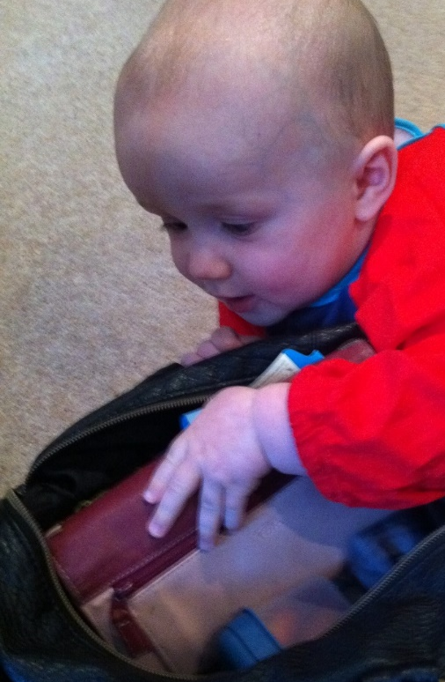
Preventing poisoning
Inquisitive young ones will love to explore different surroundings.
Get a step ahead by looking out for things that could be inn easy reach for our convenience but are then easy for them to discover.

Slide 3
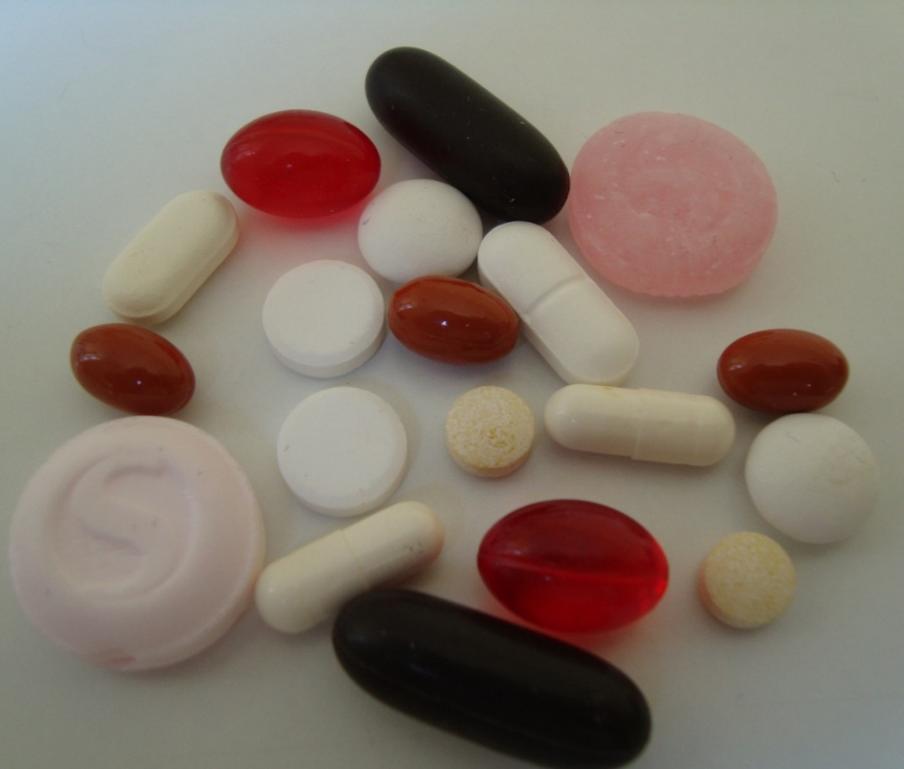
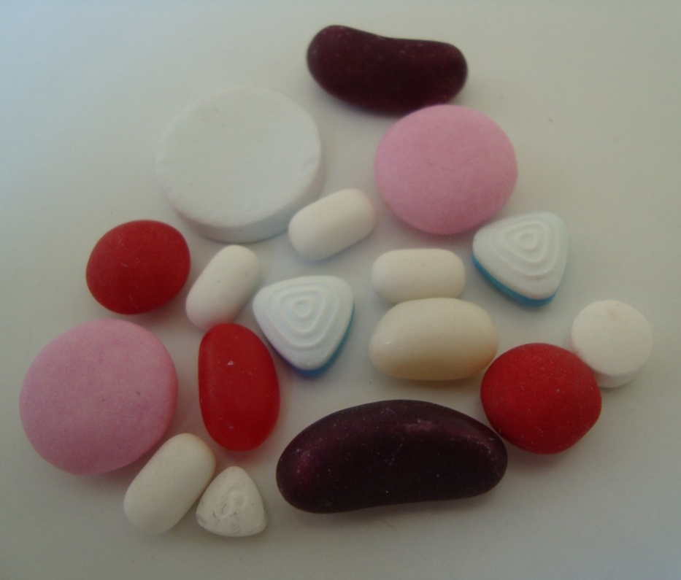
At first glance can you tell the difference?
It could be easy for a child to mistake the medicine for sweets!
(sweets on the right)

Slide 4
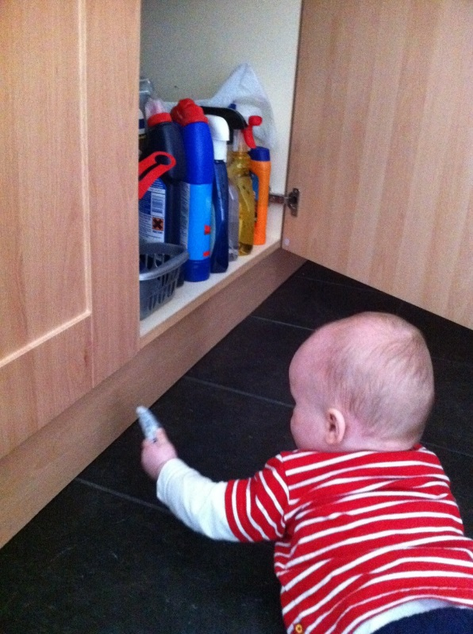
What might be in reach?

Slide 5
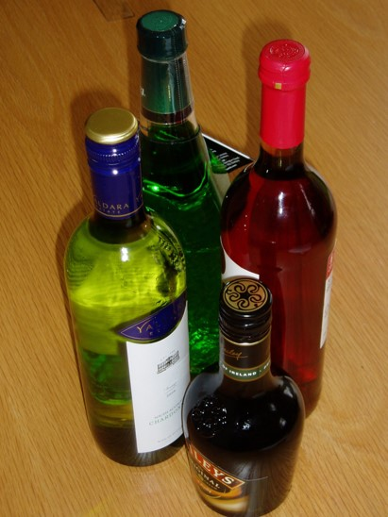
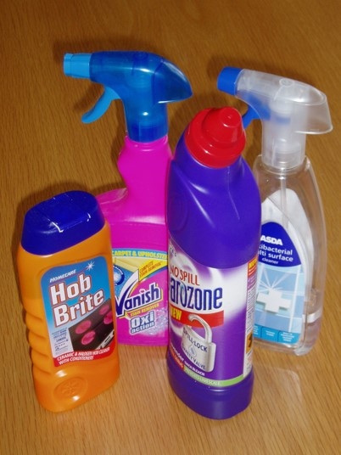
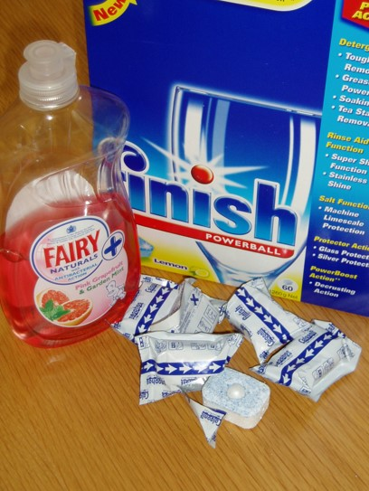
These are visually appealing … but can poison a child

Slide 6
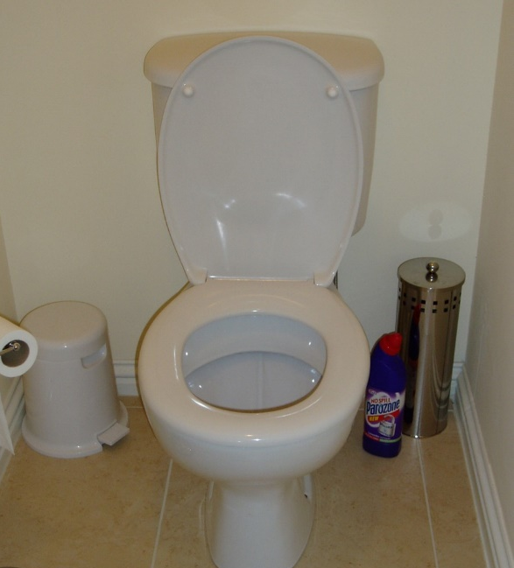
It may be handy keeping cleaning chemicals nearby but it’s also handy for a child to reach.
Do not rely on the bottle’s safety cap keeping a child from removing it! Children can be determined and pick up new skills quickly.

Slide 7
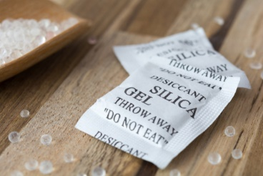
Other poisons to be aware of:
Silica Gel
These are the small packets that come inside packaging to absorb moisture. Dispose of these safely right away.
E-Cigarettes
The liquid can have an appealing smell and the packaging bright and appealing BUT is toxic. If inhaled, ingested or comes in to contact with skin/eyes it can cause very serious damage.

Slide 8
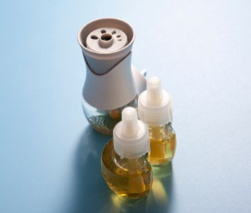
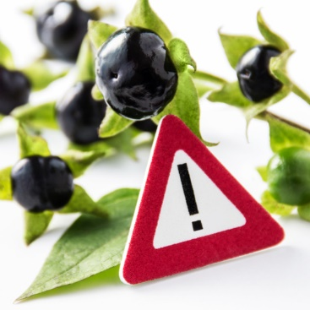
Plug-in air fresheners
The liquid contained in these can be harmful.
These devices are plugged in to the wall socket which are well within the reach of a curious child.
Plants
Be aware of which plants are poisonous - do they have berries or leaves that could be harmful if ingested or come in to contact with skin/eyes?

Slide 9
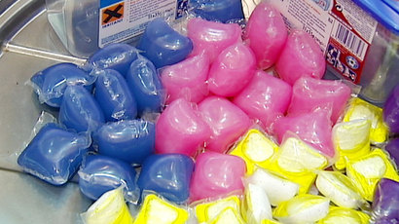
Liquitabs can cause damage to eyes or airways.
The alkaline chemicals in the liquitabs cause immediate chemical burns, causing breathing difficulties as the airways start to swell rapidly.

Slide 10
Look around the home – imagine the child’s eye view – what can they reach?
Move the poisons identified up out of children’s sight and reach.
Be alert when visiting other homes – can Granny or Granda’s medication accessed easily by a child?
If it is not possible to move items out of reach, cupboard locks or catches can be retro-fitted.
Never decant chemicals in to unmarked bottles such as empty drinks bottles.

Slide 11
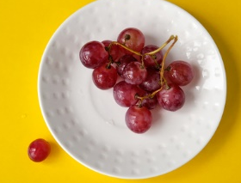
Look out for Choking hazards around the home including:
Grapes
Cherry tomatoes
Cocktail sausages
Whole nuts
Lollipops
Sweets (e.g. marshmallows or hard boiled sweets)
Marbles
Coins
Balloons
Small toys

Slide 12
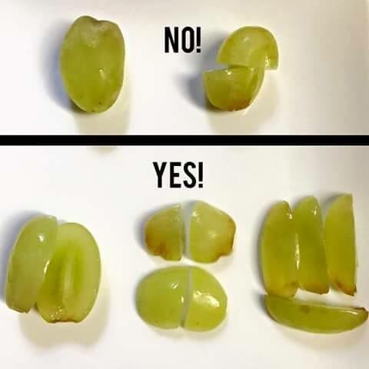
Follow these steps to help reduce the risk of choking.
Make sure food is cut into small pieces and stones and pips are removed from fruits.
Keep small items out of the reach of children.
Make sure your child plays only with toys appropriate for their age and stage of development to reduce the risk of choking.

Slide 13
Be aware that older children may share unsuitable objects with younger siblings.
Dispose of broken toys.
Never place hair bands, clips or hair ties on babies.
Do not put jewellery of any kind on a child under three years of age.

Slide 14
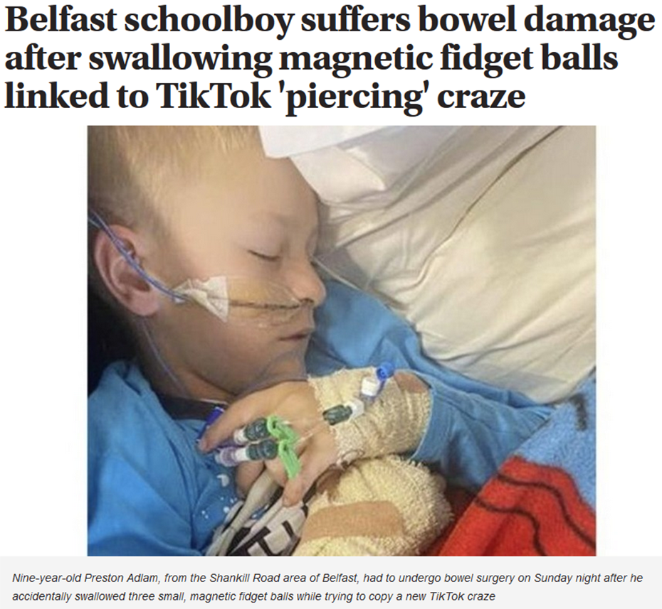
Magnets are a choking hazard but can cause other injuries too
BBC News 11/08/2021
Irish News 22/09/2021

Slide 15
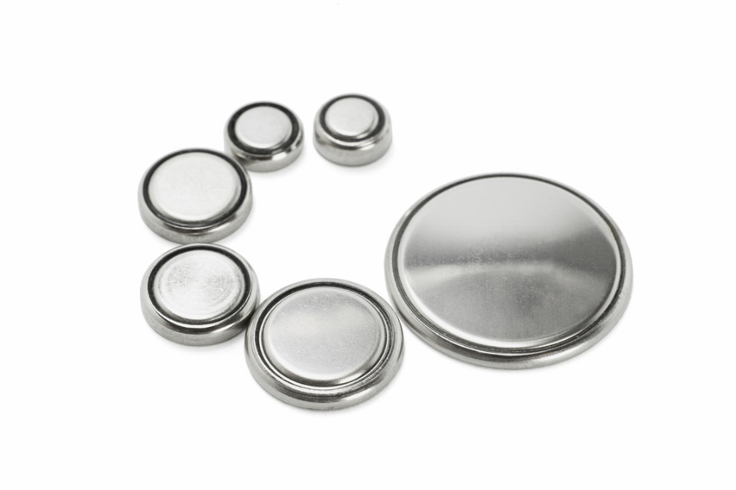
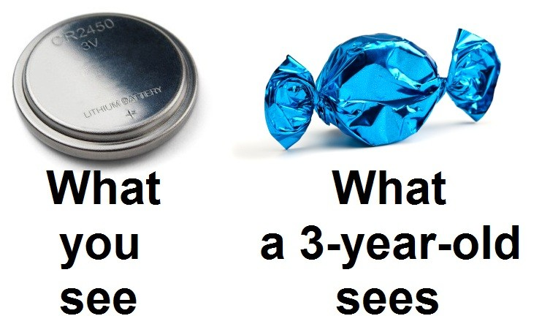
Likewise, Button Cell Batteries are a choking hazard but can also cause internal injuries if swallowed.

Slide 16
So what should I do?
Look around the home for items that may contain small magnets and keep them out of sight and reach.
When buying toys make sure they are age appropriate and have to CE mark.
Check old toys that have come out from the loft or garage are safe.
Ensure items that use button batteries have secure battery compartment covers.

Slide 17
NI Direct has a video that shows what to do if a child is choking: nidirect.gov.uk/articles/choking
If a child is choking:
If they are coughing after swallowing an item, encourage them to carry on coughing to bring up what they're choking on. Do not leave your child alone.
If your child's coughing isn't effective, it's silent, they can't breathe in properly or speak, or are unconscious call for help immediately on 999.

Slide 18
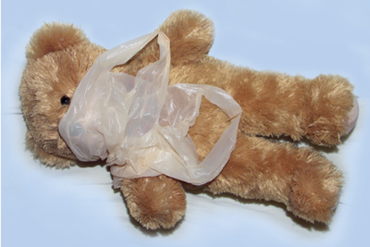
Preventing Suffocation
Babies naturally grasp things and bring things to their face so we need to be alert to suffocation hazards.
Nappy Sacks are made of flimsy plastic and can cling to a baby’s face or obstruct the airway if placed in or over their mouth.

Slide 19
Store Plastic Bags up out of reach of children.
Tie plastic bags in a knot so that if a child did get hold of it then it would be harder to pull over their head.
Keep cots free from clutter like soft toys, cot bumpers and soft, pliable bedding. These can mould around a baby’s face and lead to suffocation.
Choose a cot that meets the British safety standard (BSEN716) as it will have been designed to reduce the number of accidental deaths due to suffocation and strangulation.

Slide 20
Preventing Drowning
A small child can drown in as little as 3 cm of water!
Beware of ponds and other containers that can collect water such as paddling pools, sand pits and buckets. Restrict access with fencing and do not leave things (e.g. buckets) around that water can collect in.
Always supervise bath time. Be careful with bath seats – these can tip over and, if unattended, the baby will not be able to lift themselves out of the water.

Slide 21
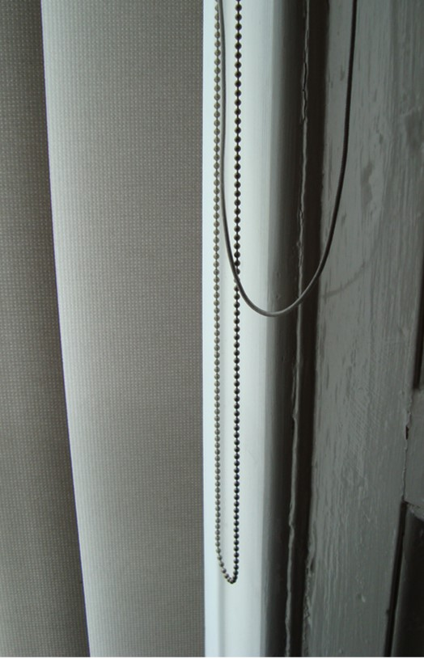
Loose Window Blind cords can be a risk to babies and small children. If looped cords and chains can be reached they could injure or strangle themselves.
Window Blind Cord safety

Slide 22
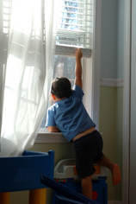
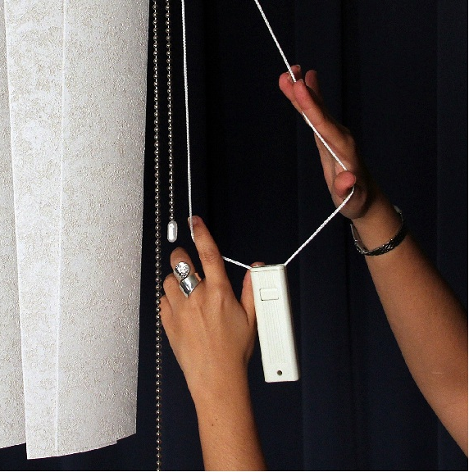
Looped Blind Cords
Access
+

Slide 23
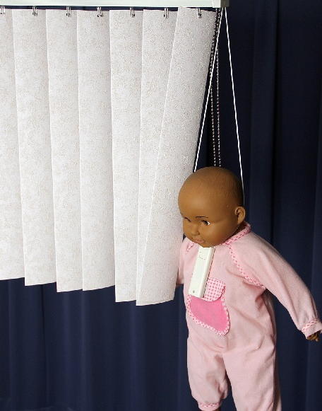
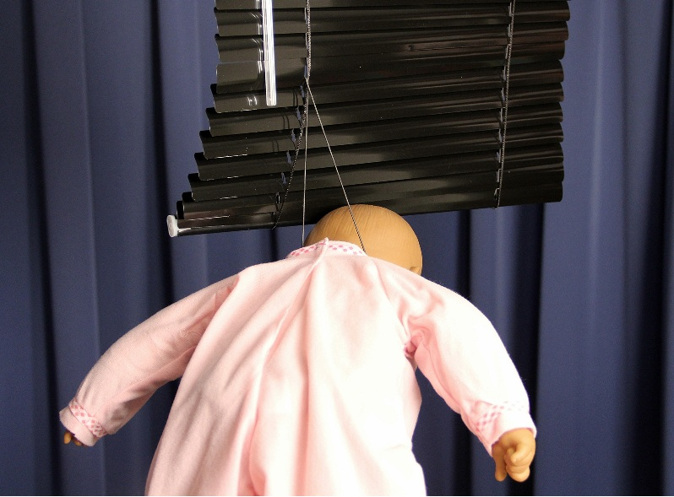
Can lead to this….

Slide 24
So what should I do?
Keep cords out of reach
safety devices can be retro-fitted to existing blinds.

Slide 25
All blinds produced and sold after February 2014 must comply with specific child safety requirements and so will either have no exposed cords or should be fitted with safety devices.
Look out for other strangulation hazards such as baby monitor leads or phone chargers.
Move potential hazards up out of children’s sight and reach.

Slide 26
A child’s skin is 15 times thinner than an adult and will burn or scald more severely and more easily.
Young children, until they develop both strength, balance and understanding, are at particular risk and need those around them to help keep them safe.

Slide 27
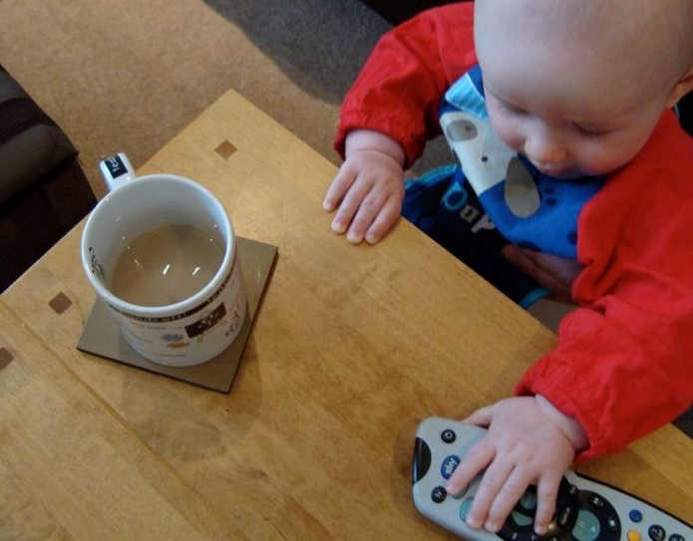
Preventing Scalds
A cuppa can stay hot enough to scald a baby for 15 minutes!
Keep them out of reach and don’t hold a baby or child while drinking a cuppa.

Slide 28
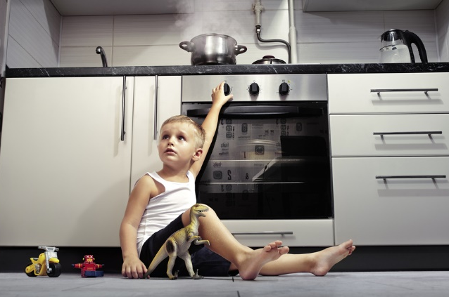
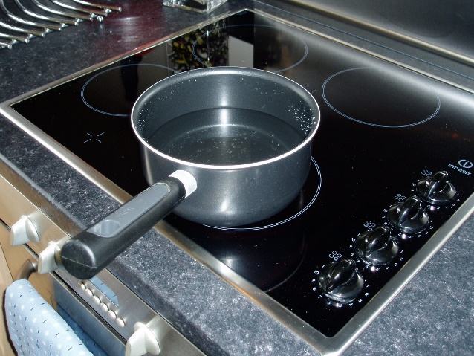
Hot liquids in kitchen
Keep children out of the kitchen.
Make sure the Kettle and it’s flex are away from the edge of the kitchen counter so it cannot be grabbed by a small child or knocked over.
Use the back rings on the cooker and keep saucepan handles turned away from the edge.
Minimise the distance that hot pans and kettles have to be moved.
X

Slide 29
Preventing bath scalds
Supervise bath time – it only takes a second for an accident to happen. Before running the bath bring all you will need within reach of the bath so that you don’t need to turn or move away and keep the child from getting in to the water before it is ready.
Run COLD water into the bath before adding the HOT water (recommended temperature is 37°C).
Test the water with your elbow or inside of your wrist for a slow count of 5. It should be comfortably warm – not hot.

Slide 30
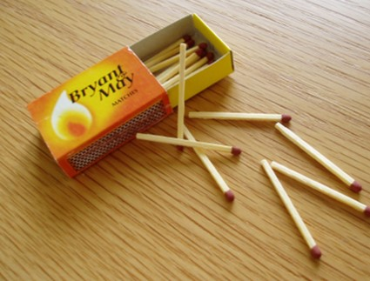
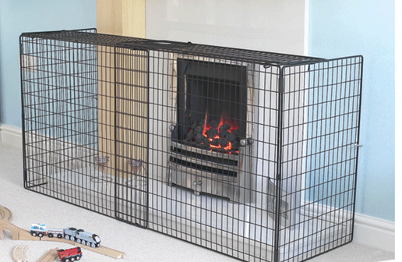
Preventing Burns from dry heat sources
Keep matches and lighters out of children’s sight and reach.
Fit a Fire Guard around the fireplace to keep children a safe distance from open fires and stoves.

Slide 31
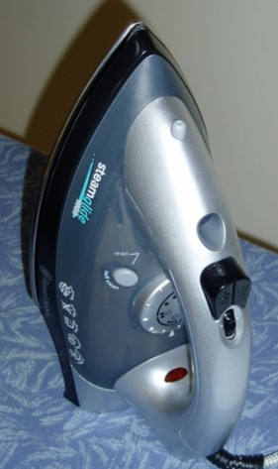
Ensure ironing is always done when children are not around.
Keep the iron on a heatproof surface when heating up/cooling down.
Make sure the cord is not within a child’s reach.

Slide 32
1 in 10 children admitted to hospital* with a burn were injured by Hair straighteners. When fully heated up the hotplates reach over 200˚C
Keep children away when using them and use a heatproof mat/case to set them on and to cool down in. It can take over 30 minutes to cool down completely!
*Royal Belfast Hospital for Sick Children

Slide 33
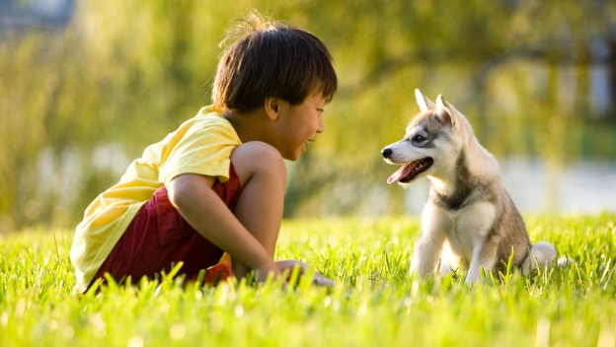
Children and pets.
Always remember
– Don't leave young children unsupervised with a pet.
Dogs are often considered a member of the family but a mistake we can make is to forget that they, like humans can get stressed, frightened or angry which could lead to them to act aggressively if provoked.

Slide 34
Teach children how to behave around dogs (and other pets too).
Teach children to:
Be calm
Give a dogs space
Keep hands away from dog’s eyes, mouth and ears.
Be kind.
Leave a dog alone when they are sleeping, eating of playing with it’s toy.

Slide 35
For more information please contact us on:
028 9034 0160
envhealth@antrimandnewtownabbey.gov.uk
Thank you

