Slide 1
Notes:
In 2016, as community planning and planning powers were starting to get embedded into the Council, in Partnership with the Housing Executive we commissioned a place shaping study.
Place shaping was a relatively new idea for us – thinking about what makes a good place to live, a good place to invest, a good place to work and a good place to spend leisure time meant having to think about a whole range of issues.
An organisation called Place worked with the Ulster University and with Paul Hogarth Consulting to talk to residents and organisations to really think about Monkstown and the surrounding area and what improvements could be made.

Slide 2
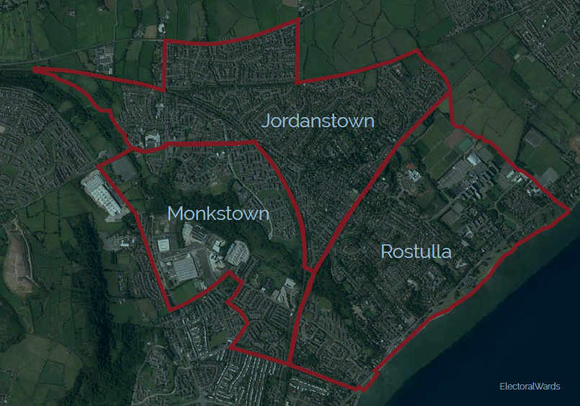
Project Area
Notes:
The first thing to say is that “greater Monkstown” was a place largely invented by us.
It was important in conducting this study that we looked not just at Monkstown estate but at the surrounding area and the assets and opportunities available there.
The Greater Monkstown area as we designated it for this study incorporates Monkstown estate, stretches down into Jordanstown and up to the Doagh Road and Old Carrick Road.

Slide 4
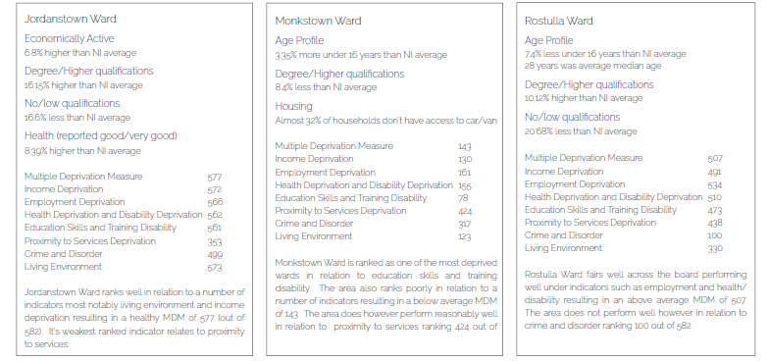
Key Statistics
Notes:
It is an area

Slide 5
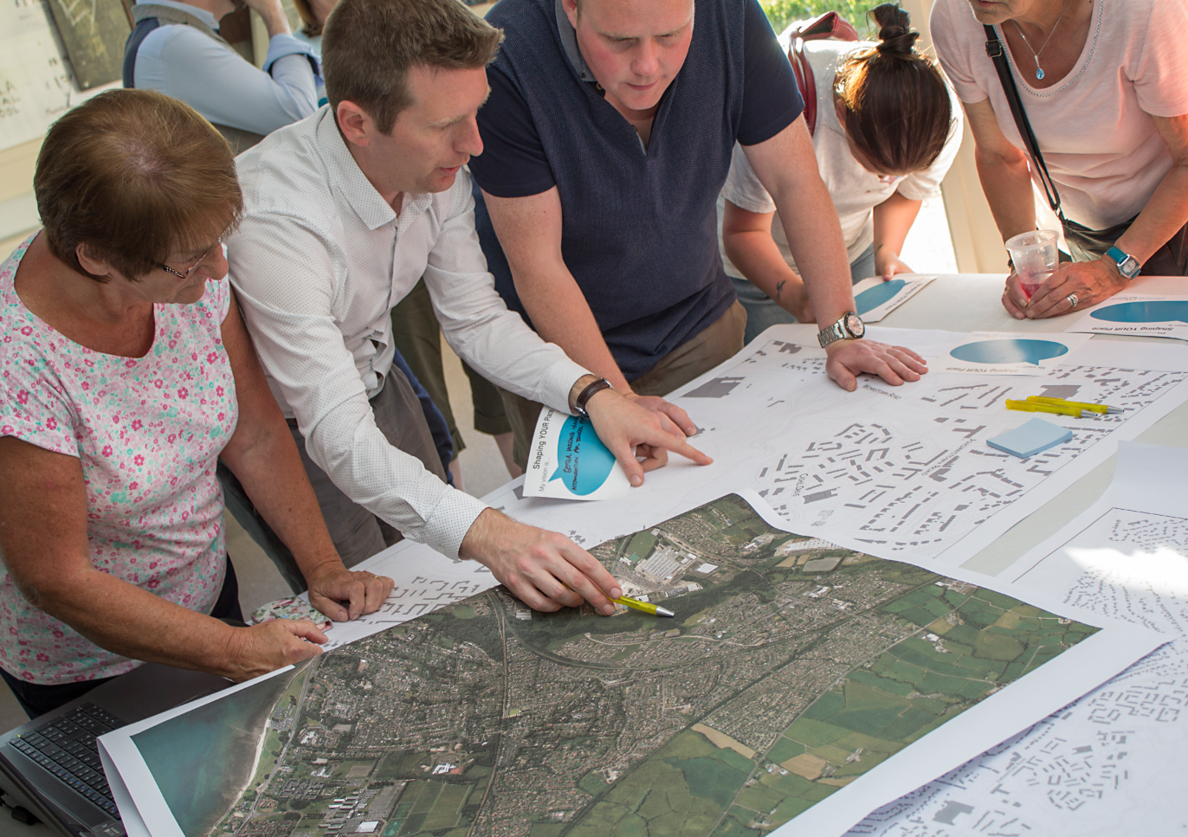
The Engagement Process
Stakeholder Engagement (Statutory Organisations)
Community Organisations
Schools
Community Engagement

Slide 6
Engagement Findings
Community: A clear sense of identity and affinity with Monkstown amongst its residents.
Housing: A real and a perceived housing need to include a more sustainable mix of type.
Facilities: A relatively good range of services and facilities in comparison to adjacent, predominantly residential suburban areas. Some notable absences however (e.g. Health, Large Supermarkets).
Centres: An evolution of small but important neighbourhood centres, currently the ‘Village Centre’ and Jennings Park and previously Abbeytown Square. Future sustainability of these is a key issue.
Health: Concern over health issues, including addiction and associated behaviours.
Perceptions: Negative, largely external perceptions of Monkstown influenced by historical events, perceived antisocial behaviour and the physical environment (including vacant buildings and spaces, litter and paramilitary symbols).

Slide 7
Fragmentation: A complex dynamic of spatial and social division occurring across socio-economic factors (income, health, education etc.), housing tenures and loyalist identities. Physical barriers caused by transport infrastructure, street networks, natural features and landuse.
Landscape: A major natural resource on the doorstep of Monkstown, although local usage influenced by perceptions of safety.
Opportunities: . Specific sites with development potential, including housing areas, Moylinney House, Abbeytown Square and Village Square allotment site.

Slide 8
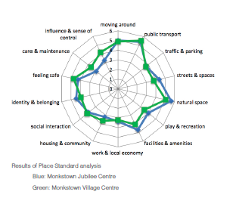
Place Standard
Care and Maintenance 2.0-2.5
Housing and Community 3.0-3.5
Work and Local Economy 3.5
Traffic and Parking 3.5
Play and Recreation 3.5-4.0
Influence and Sense of Control 3.5-4.0
Social Contact 4.0
Facilities and Amenities 4.0-4.5
Streets and Spaces 4.0-4.5
Identity and Belonging 4.0 -4.5
Feeling Safe 4.5-5.0
Moving Around 5.0
Public Transport 5.5
Natural Space 5.5-6.0
Notes:
The simple framework does show that the results from both engagement venues are similar. Most of the highly ranked themes – or assets – of Monkstown are ‘public transport’ and ‘natural space’, followed by ‘moving around’ and ‘feeling safe and identity & belonging’.
Public Transport
Many of those that attended the events thought public transport services do, generally, meet their needs. No substantial issues were raised in discussions with people about the quality of the public transport in the area. This may indicate that the public transport services are, generally, very good and cater for a range of users.
Natural Space
People appeared to appreciate the range of different environments in the area, for example, the woodlands to the southwest of Monkstown, and the surrounding green spaces and views of Carnmoney Hill. However, further exploration with participants at the workshops highlighted that the connection between Monkstown (estate) and ‘The Woods’ could be improved. There were concerns about personal safety and anti-social behaviour that hinder people using ‘The Woods’ and accessing the green corridor linking Glen Park (to the SE) and Three Mile Water Conservation Park (to the NW). There was very little reference made to using these natural spaces for health and well-being reasons
and benefits. The surrounding natural spaces appear to be valued, but underused.
Moving Around
There was a general perception that the routes in the local neighbourhood were easy to navigate, which may be because of the intimate knowledge local residents have of their surrounding geography. Most routes do provide direct links to local services, such as shops and to public transport. However, some comments were raised about the mobility of older people, particularly those lower down in the estate, having to walk up to access shops and services. There was no mention of cycling by those at the workshops.
Feeling Safe and Identity & Belonging
Generally, most people feel safe in the area, but some negative features affect how people ‘feel’ about their place. For example, a number of people stated that empty/derelict properties are an eyesore. In addition, some people referred to anti-social behaviour in the area, particularly from young people, and some highlighted this occurring in the green spaces (‘The Woods’). In part, feeling safe may also be due to the fact that people have a strong sense of belonging to the place and a collective community identity associated with Monkstown. However, some mentioned that further work to promote the historical, heritage and cultural assets of the place could be enhanced to strengthen (intergenerational and community) bonds, attract tourism and to present the place in a more positive way.
Some place qualities that require a degree of improvement would be traffic & parking, work & local economy, housing & community, care & maintenance, and influence & sense of control.
Traffic & Parking
The average mid-range rating may indicate that there are traffic and parking issues. The place appears to be dominated by traffic and parked cars, particularly around the Village Centre, which has a negative impact on people’s daily lives – and how they perceive the Village Centre as a civic space for the surrounding community. Several participants highlighted car parking issues around apartment complexes in the estate.
Work & Local Economy
It appears that there is room for improvement in creating a thriving local economy, so local people have job opportunities and/or the support services to find and keep work. There are vacant units in the Village Centre. Some of the challenges of improving employment and economic well-being in the area may be related to the value placed on education and/or long-term (mental) health issues.
Housing and Community
While there is a mid-range rating for housing, quite a lot of participants highlighted the need for a better range of housing types and tenures to meet the demands of those living longer and for younger people from the community being able to access social or affordable housing. Linked to this is the care and maintenance quality, because several participants also mentioned that some residents do not look after their property. Some of the challenges, for example, the ability for residents to maintain a household or possess adequate life-skills for independent living, are compounded by the lack of different service providers sharing information and sharing responsibility to address complex, interconnected social problems.
Influence & sense of control
Linked to the above, people also thought that they are unable to contribute to decisions that affect them. There could be further room for improvement in empowering local people to actively work with the local Council and service providers to co-design solutions and, where possible, for the community to deliver solutions.

Slide 9
Priority Objectives
Cohesive Community
Strengthened Core
Enriched Landscape
Positive Connections

Slide 10
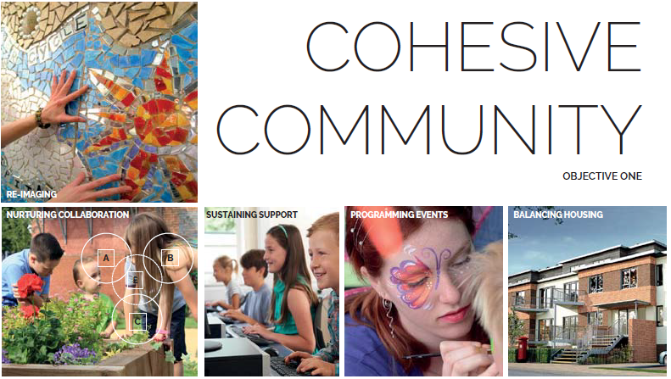

Slide 11
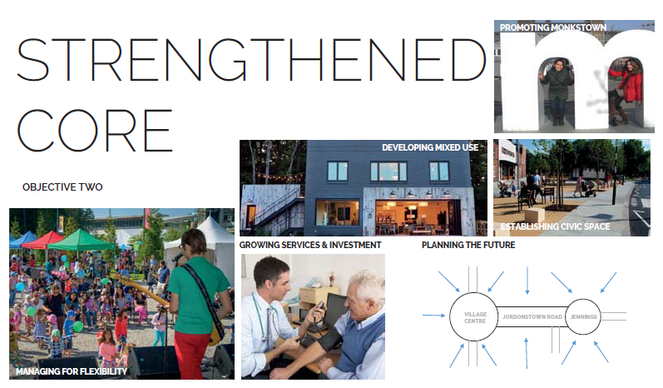

Slide 12
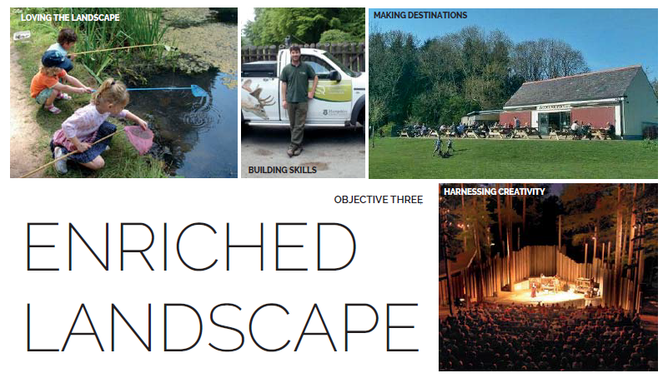

Slide 13
