Slide 1

Planning Committee
13th December 2021

Slide 2
Item 3.1
Planning Application: LA03/2021/0950/O
Proposal: Proposed infilling of a single dwelling
Site Address: Lands between 43b and 43e Nutts Corner Road, Crumlin, BT29 4SQ
Recommendation: Refuse Outline Planning Permission

Slide 3
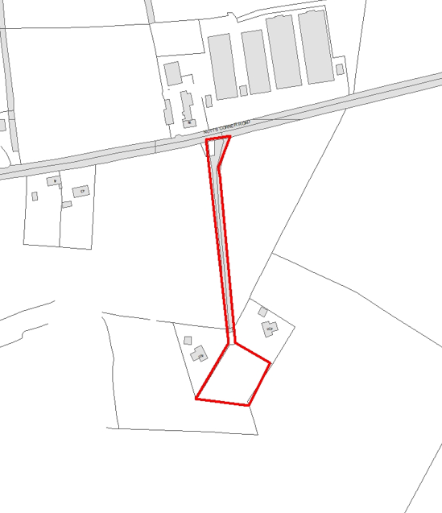

Slide 4
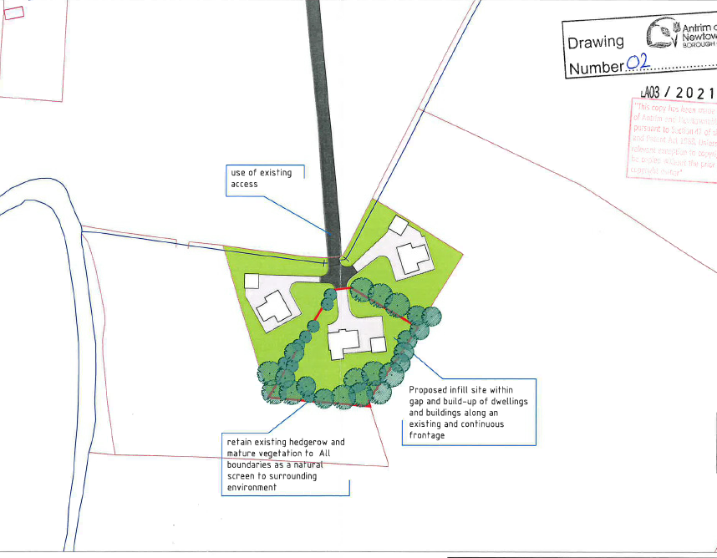

Slide 5
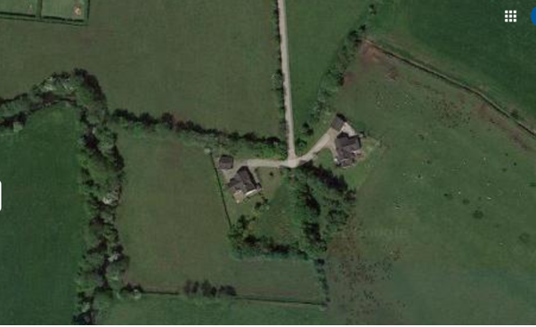

Slide 6
Item 3.2
Planning Application: LA03/2020/0339/F
Proposal: Erection of replacement dwelling and garage plus demolition of existing dwelling
Site Address: 22 Belfast Road, Aughnamullan, Crumlin, BT29 4TQ
Recommendation: Grant Planning Permission

Slide 7
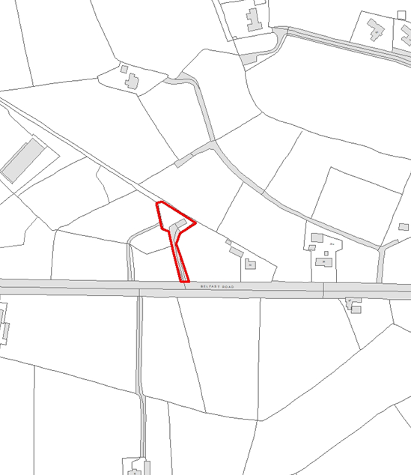

Slide 8
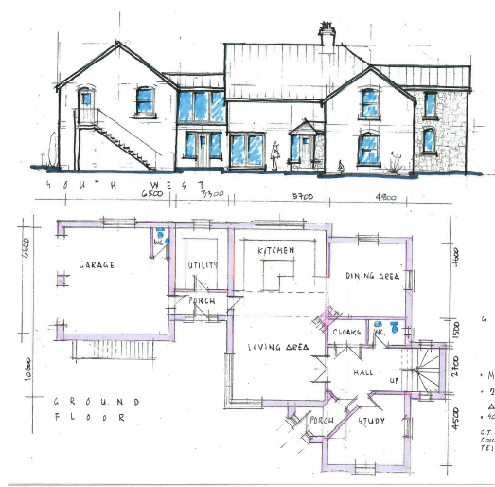

Slide 9
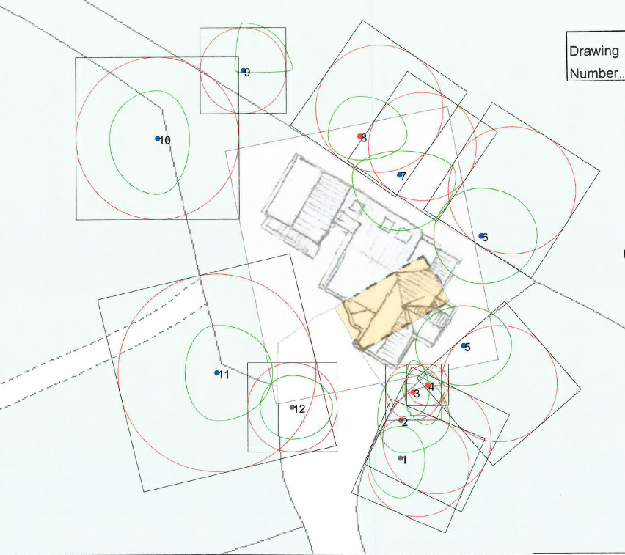

Slide 10
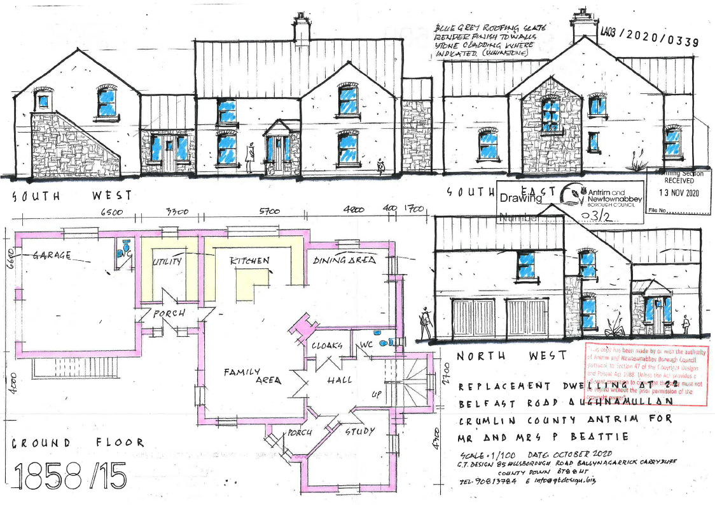

Slide 11
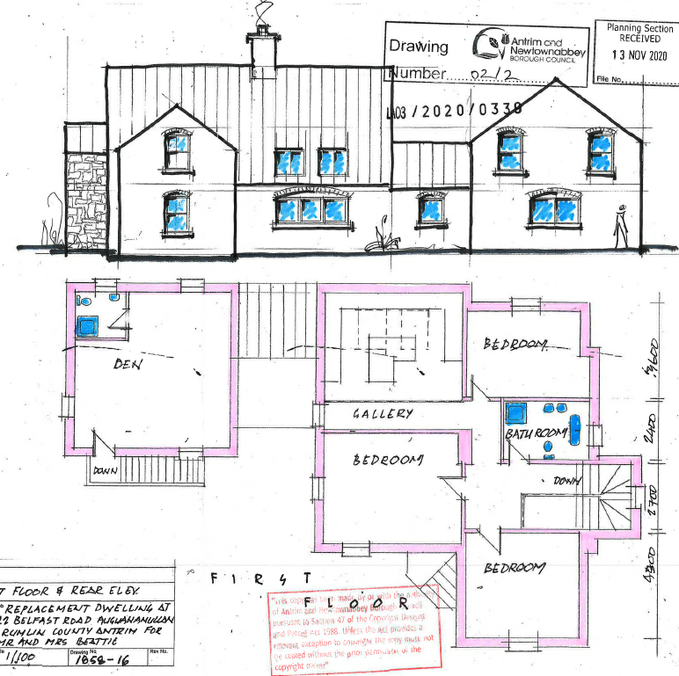

Slide 12
Item 3.3
Planning Application: LA03/2021/0791/F
Proposal: Dwelling and Garage (change of house type and garage, alteration to access from T/2003/0037/F)
Site Address: 15m south of No. 31 Lurgan Road and to the rear of 10 Cherryvalley Road, Crumlin
Recommendation: Refuse Planning Permission

Slide 13
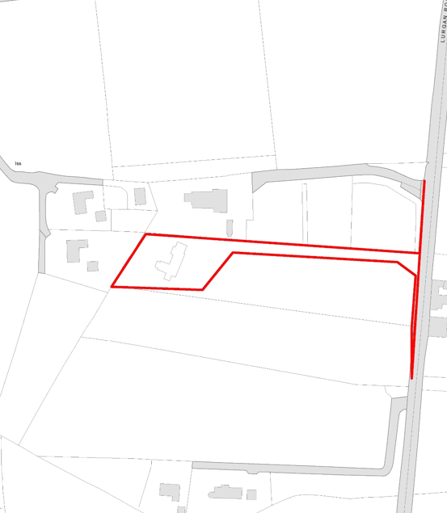

Slide 14
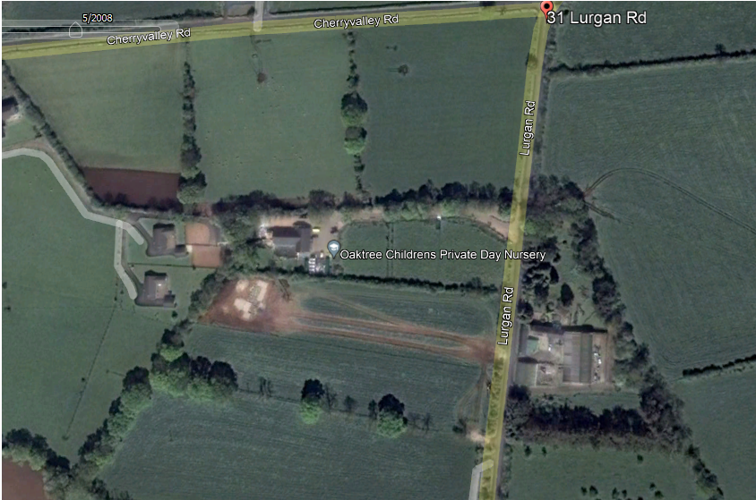

Slide 15
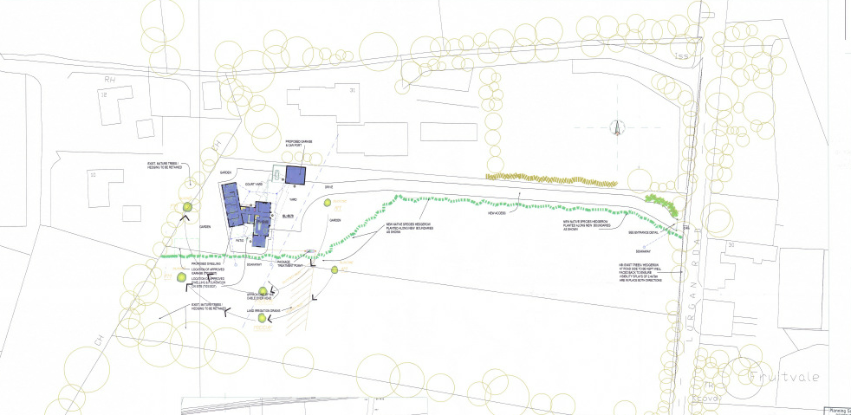

Slide 16
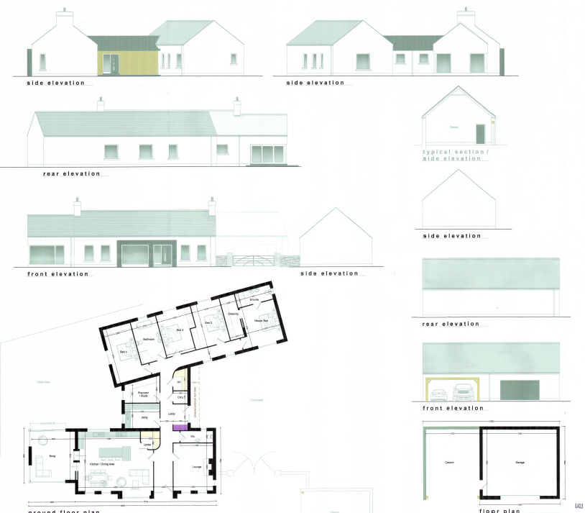

Slide 17
Item 3.4
Planning Application: LA03/2021/0897/O
Proposal: Outline planning for 2 no. proposed new infill dwellings and detached garages.
Site Address: Lands between 12a and 12c Drum Road, Kells, Ballymena, BT42 3NN
Recommendation: Refuse Outline Planning Permission

Slide 18
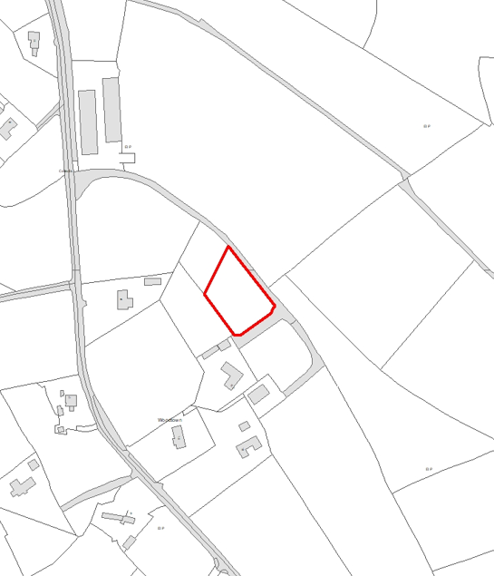

Slide 19
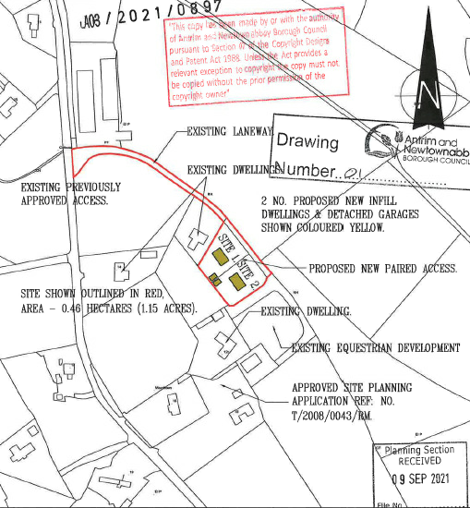

Slide 20
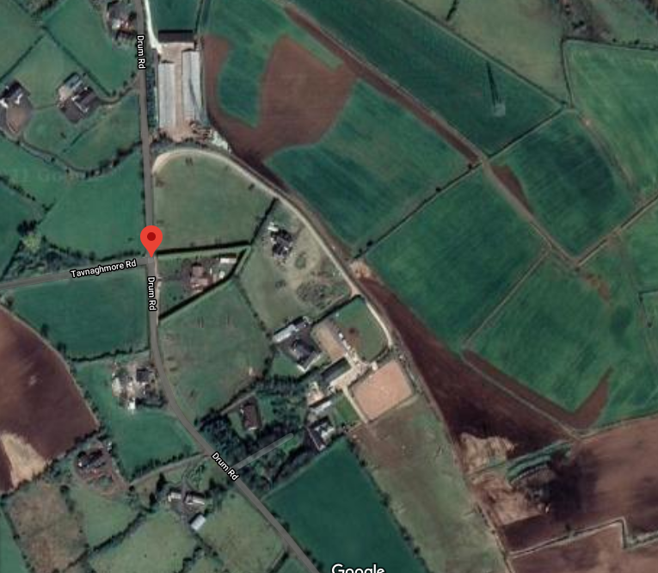

Slide 21
Item 3.5
Planning Application: LA03/2019/1049/O
Proposal: Proposed new dwelling on a farm
Site Address: Site 75m west of 19 Loup Road, Moneyglass.
Recommendation: Refuse Outline Planning Permission

Slide 22
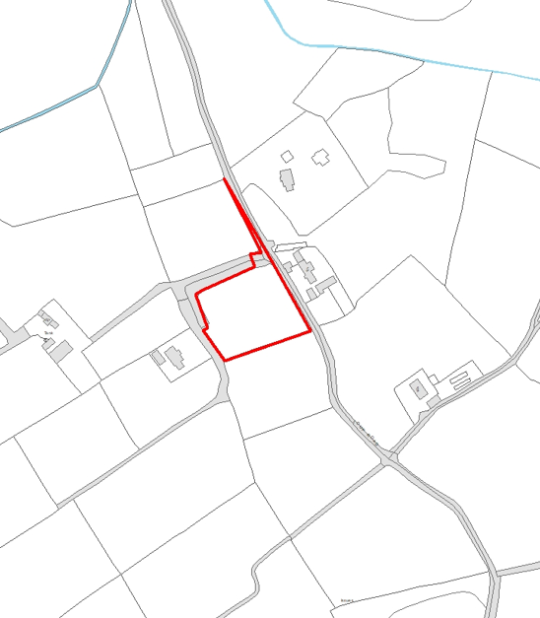

Slide 23
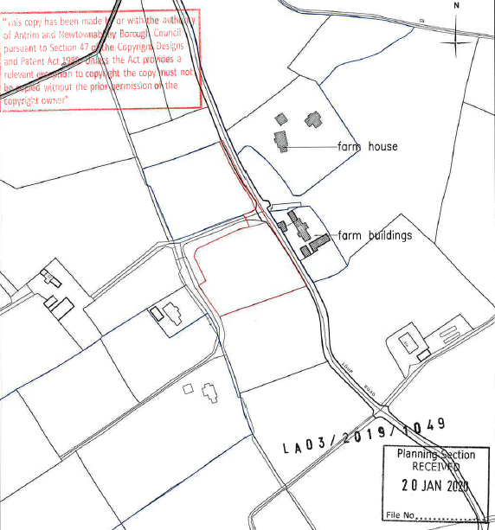

Slide 24
Item 3.6
Planning Application: LA03/2021/0993/O
Proposal: Proposed site for infill dwelling and domestic garage
Site Address: 40m East of 9a Creggan Road, Cranfield, Randalstown, BT41 3LN
Recommendation: Refuse Outline Planning Permission

Slide 25
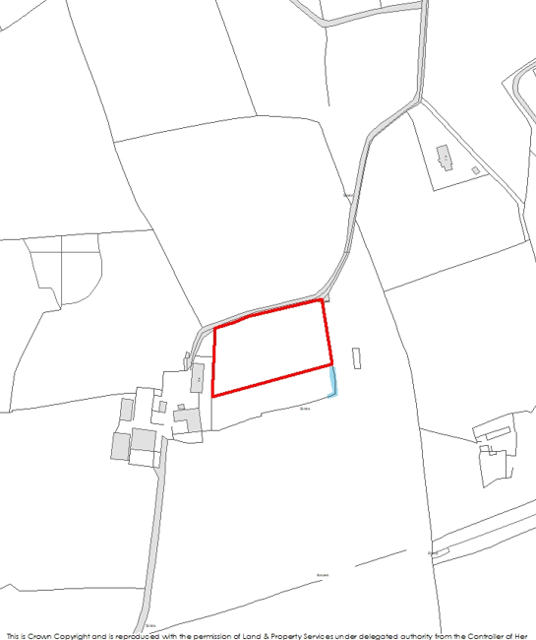

Slide 26
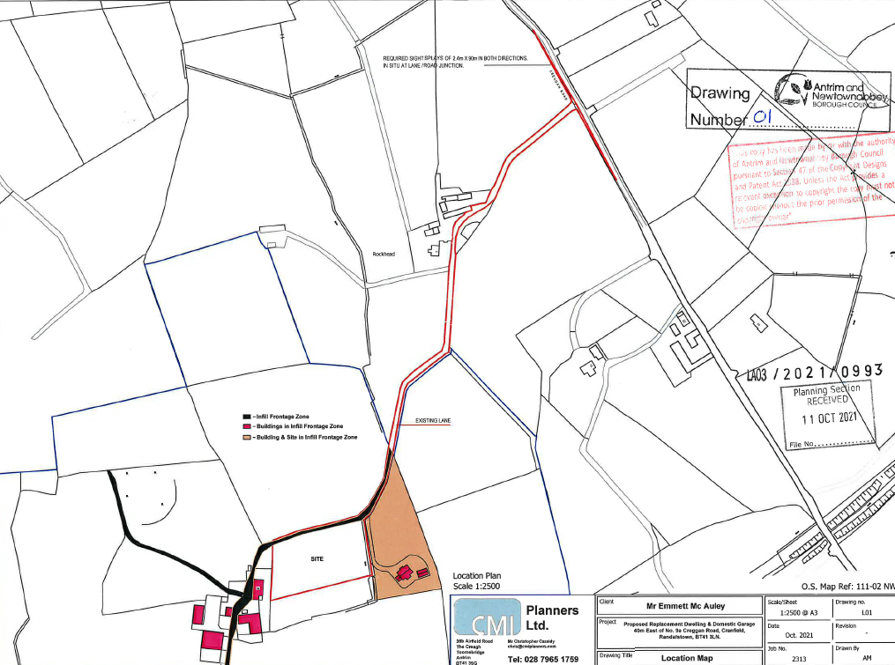

Slide 27
Item 3.7
Planning Application: LA03/2021/0805/F
Proposal: Dwelling and Garage
Site Address: 120m west of 44 Rickamore Road Upper, Templepatrick, BT39 0JE
Recommendation: Refuse Planning Permission

Slide 28
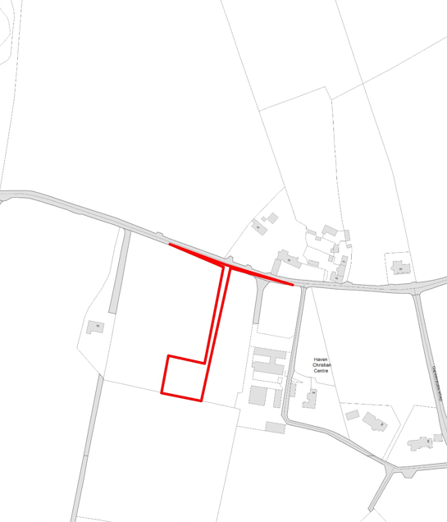

Slide 29
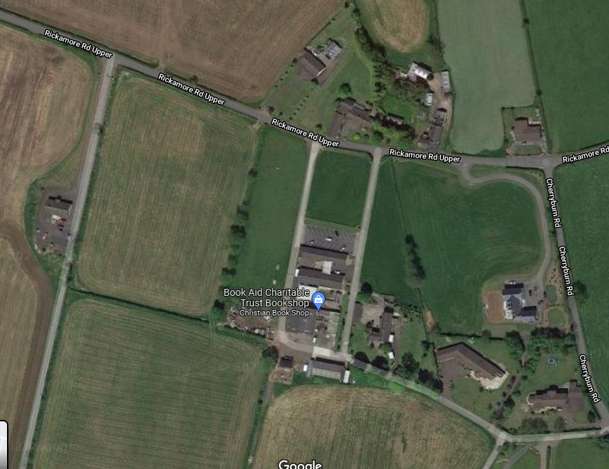

Slide 30
Item 3.8
Planning Application: LA03/2021/0896/F
Proposal: Construction of a new large glazed entrance on the Six Mile Water Riverside elevation and internal reconfiguration.
Site Address: 55-59 High Street, Antrim, BT41 4AY
Recommendation: Grant Planning Permission

Slide 31
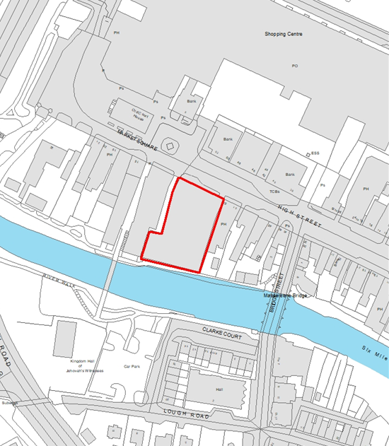

Slide 32
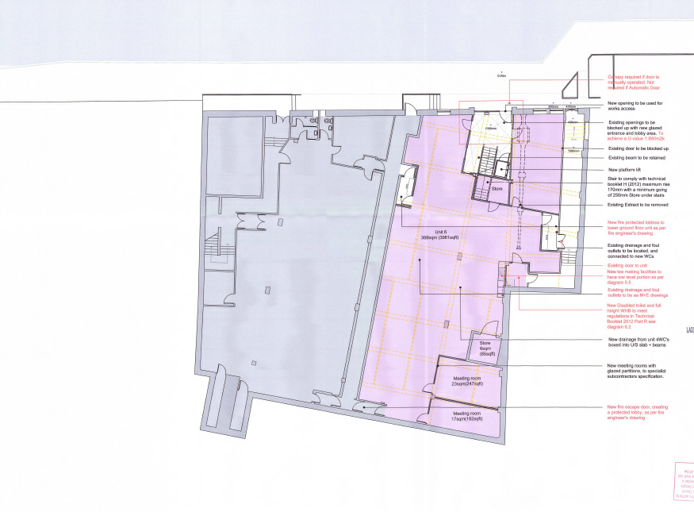

Slide 33
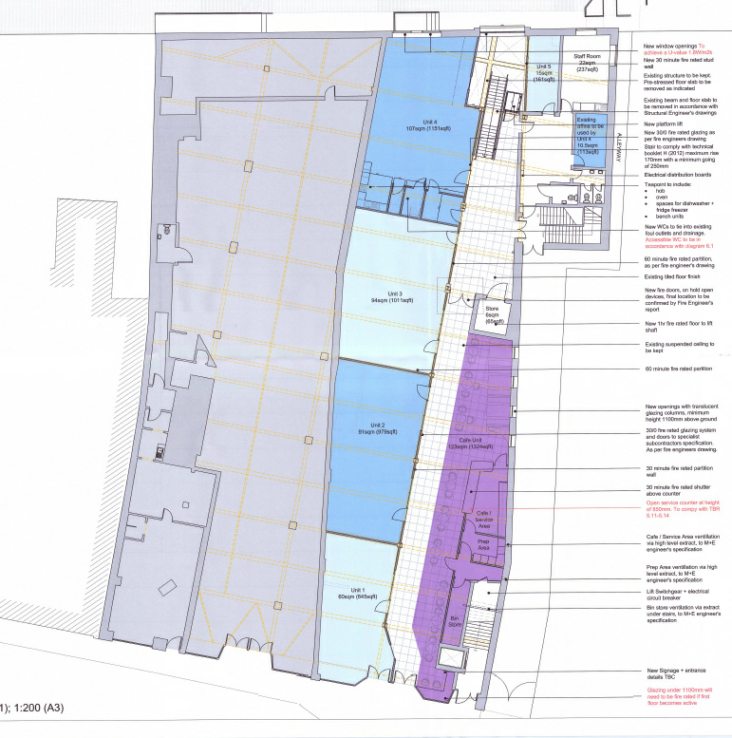

Slide 34
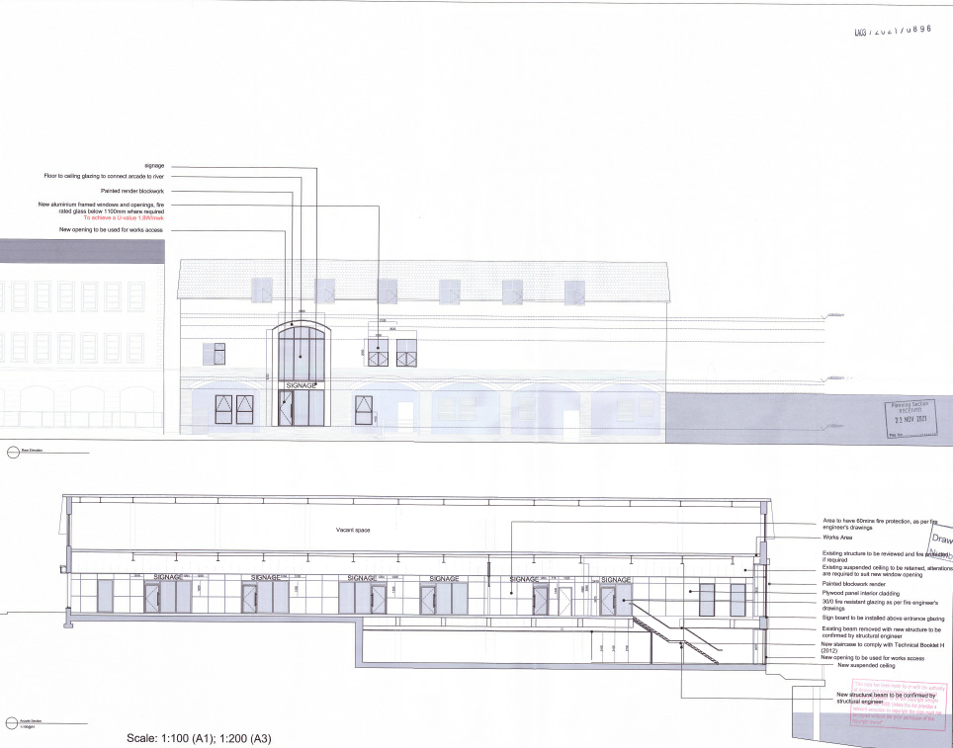

Slide 35
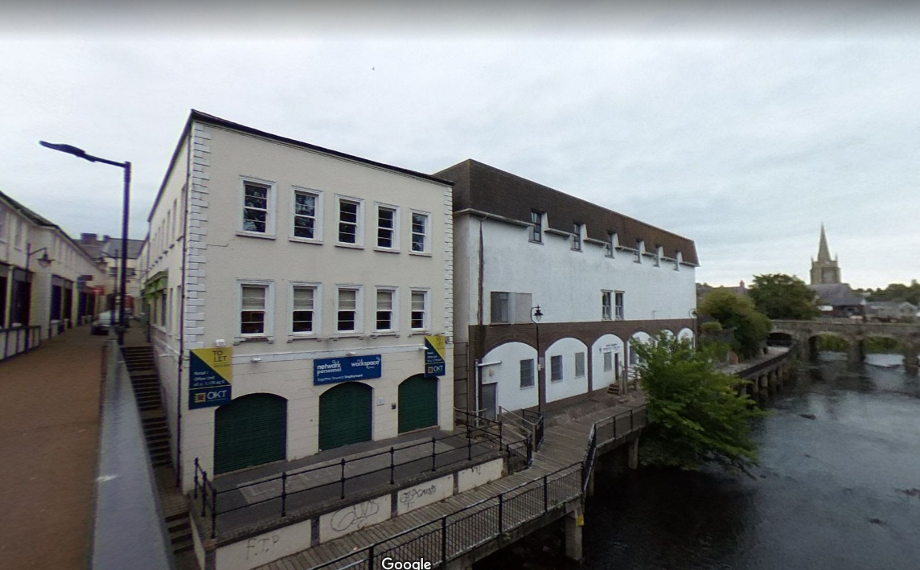

Slide 36
PART TWO Other Planning Matters
3.9 Draft Rates Estimates Update 2022/23
Presentation
3.10 Delegated Planning Decisions and Appeals
November 2021
3.11 Proposal of Application Notifications
3.12 DfI – Permitted Development Rights in relation
to Avian Flu
3.14 Supplementary Planning Report
4.0 Any Other Business

