Slide 1
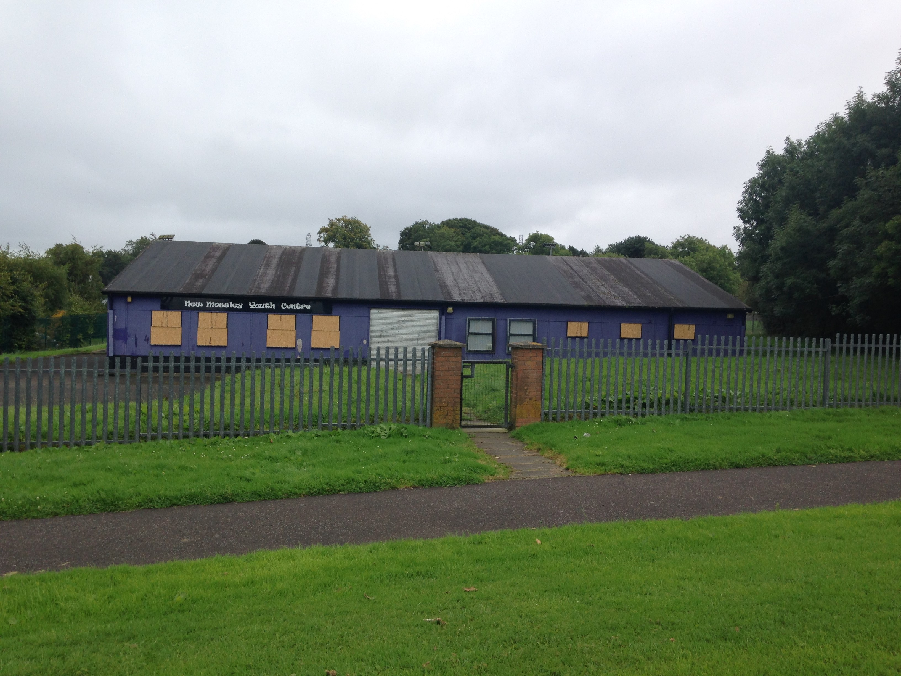
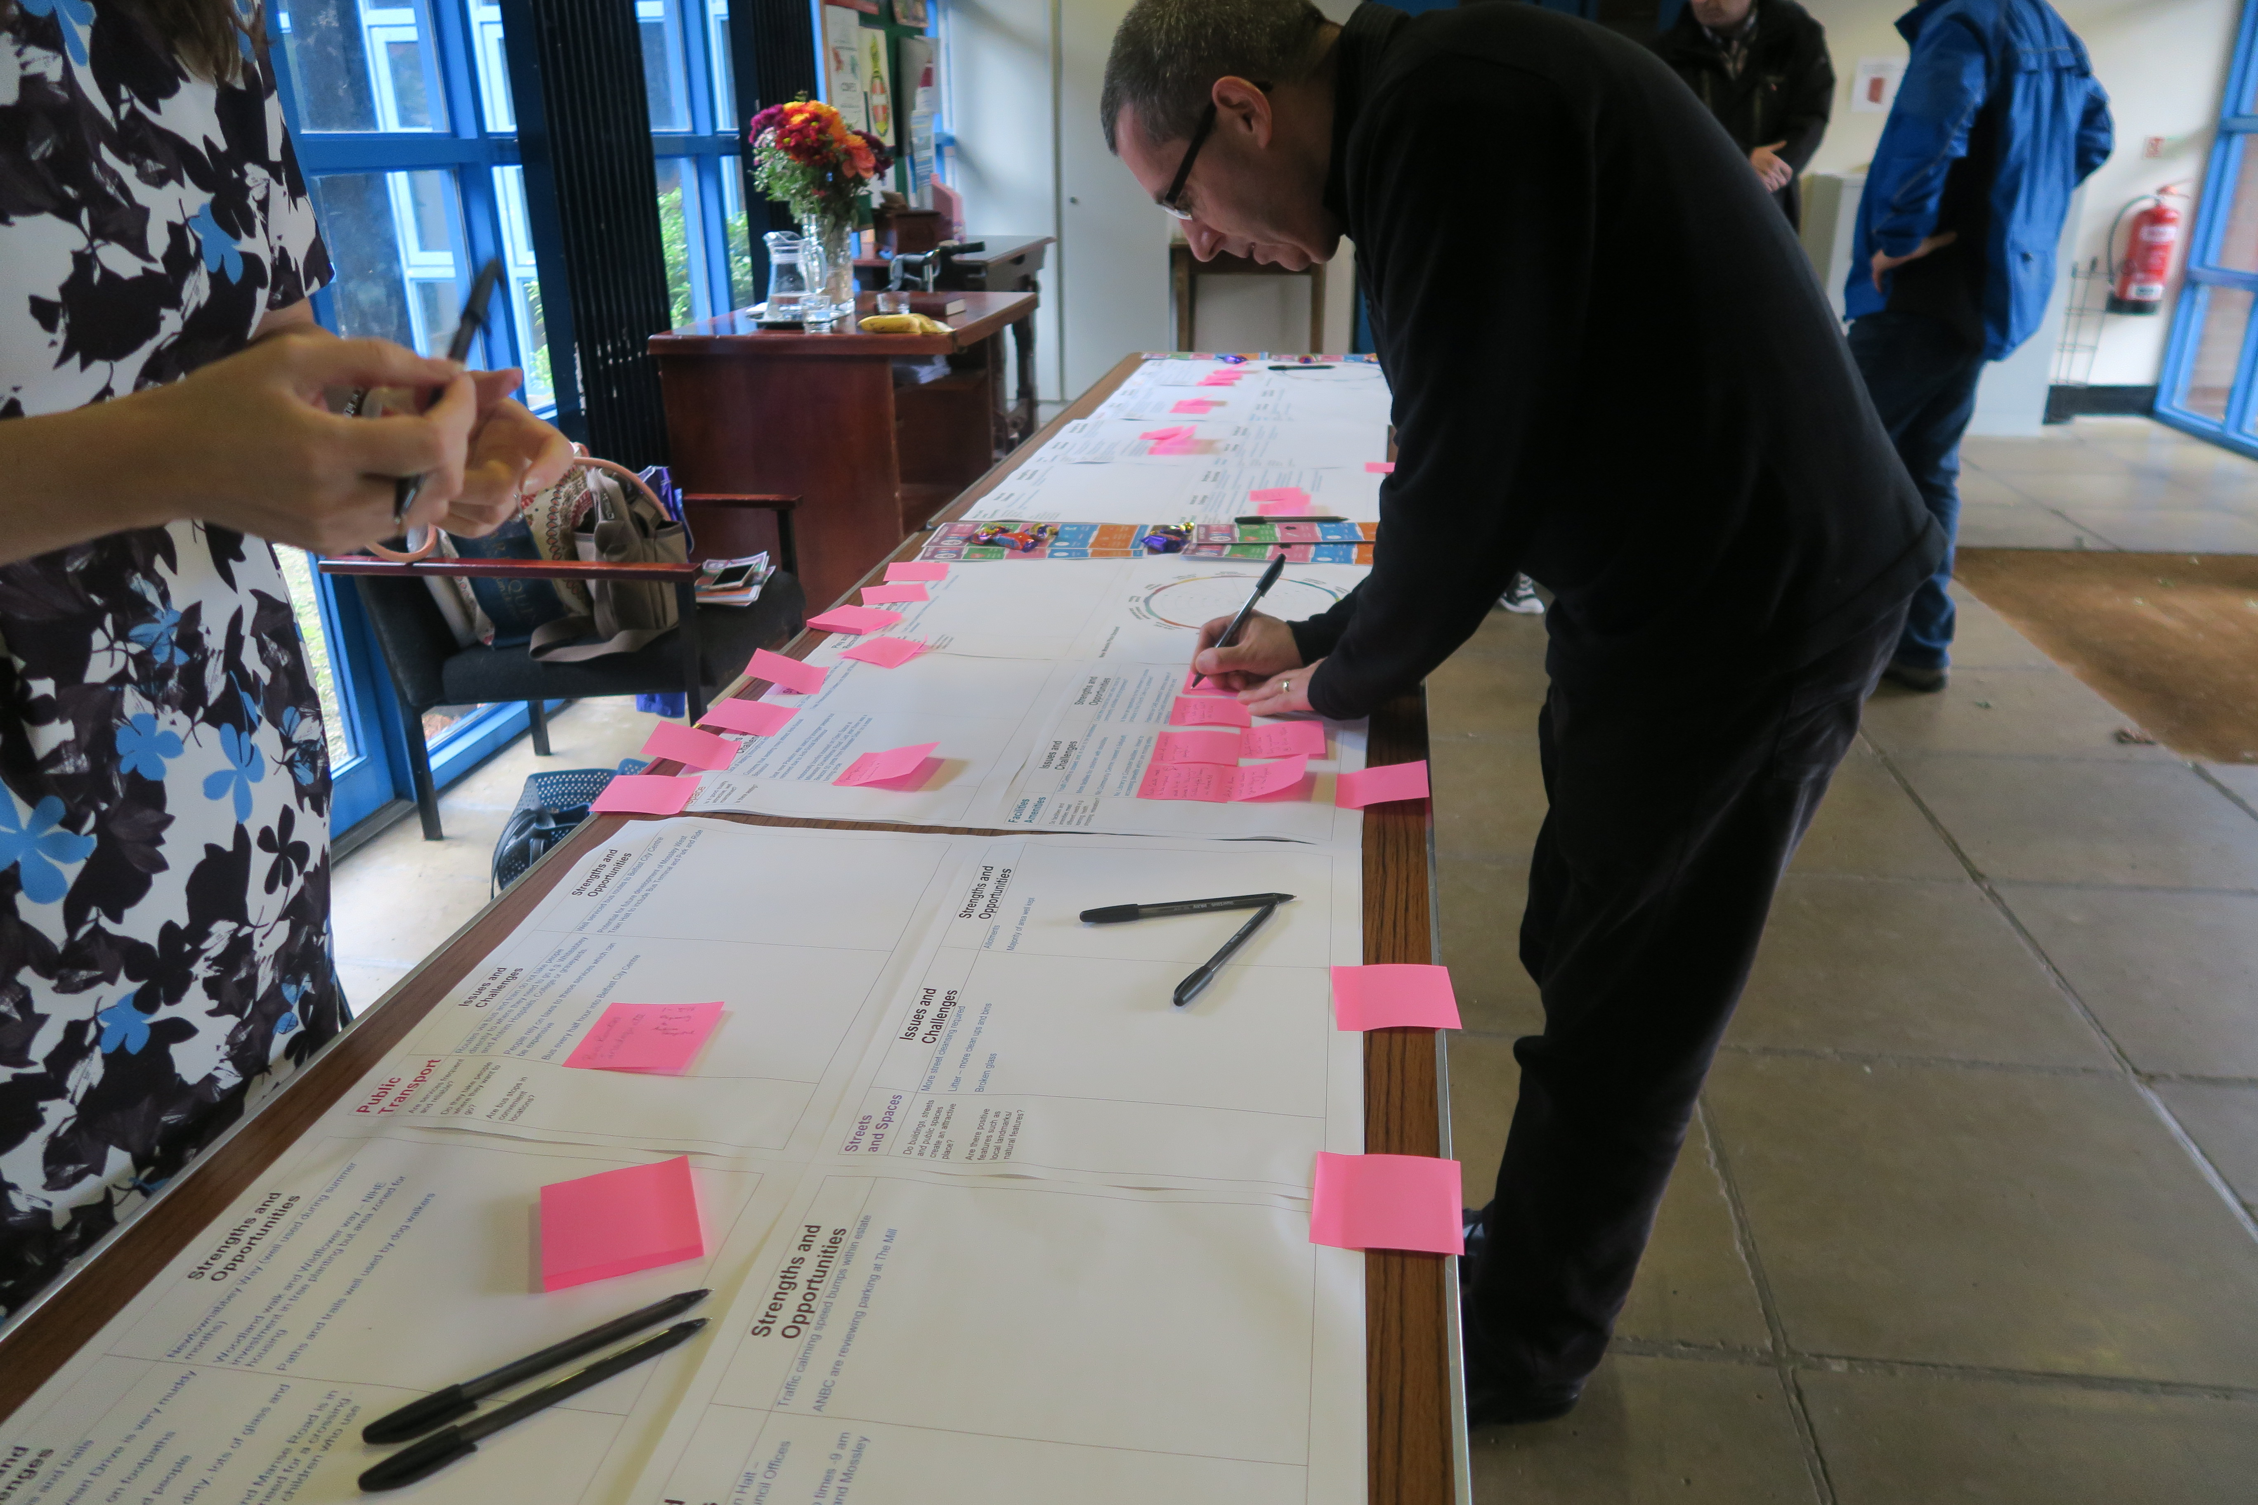
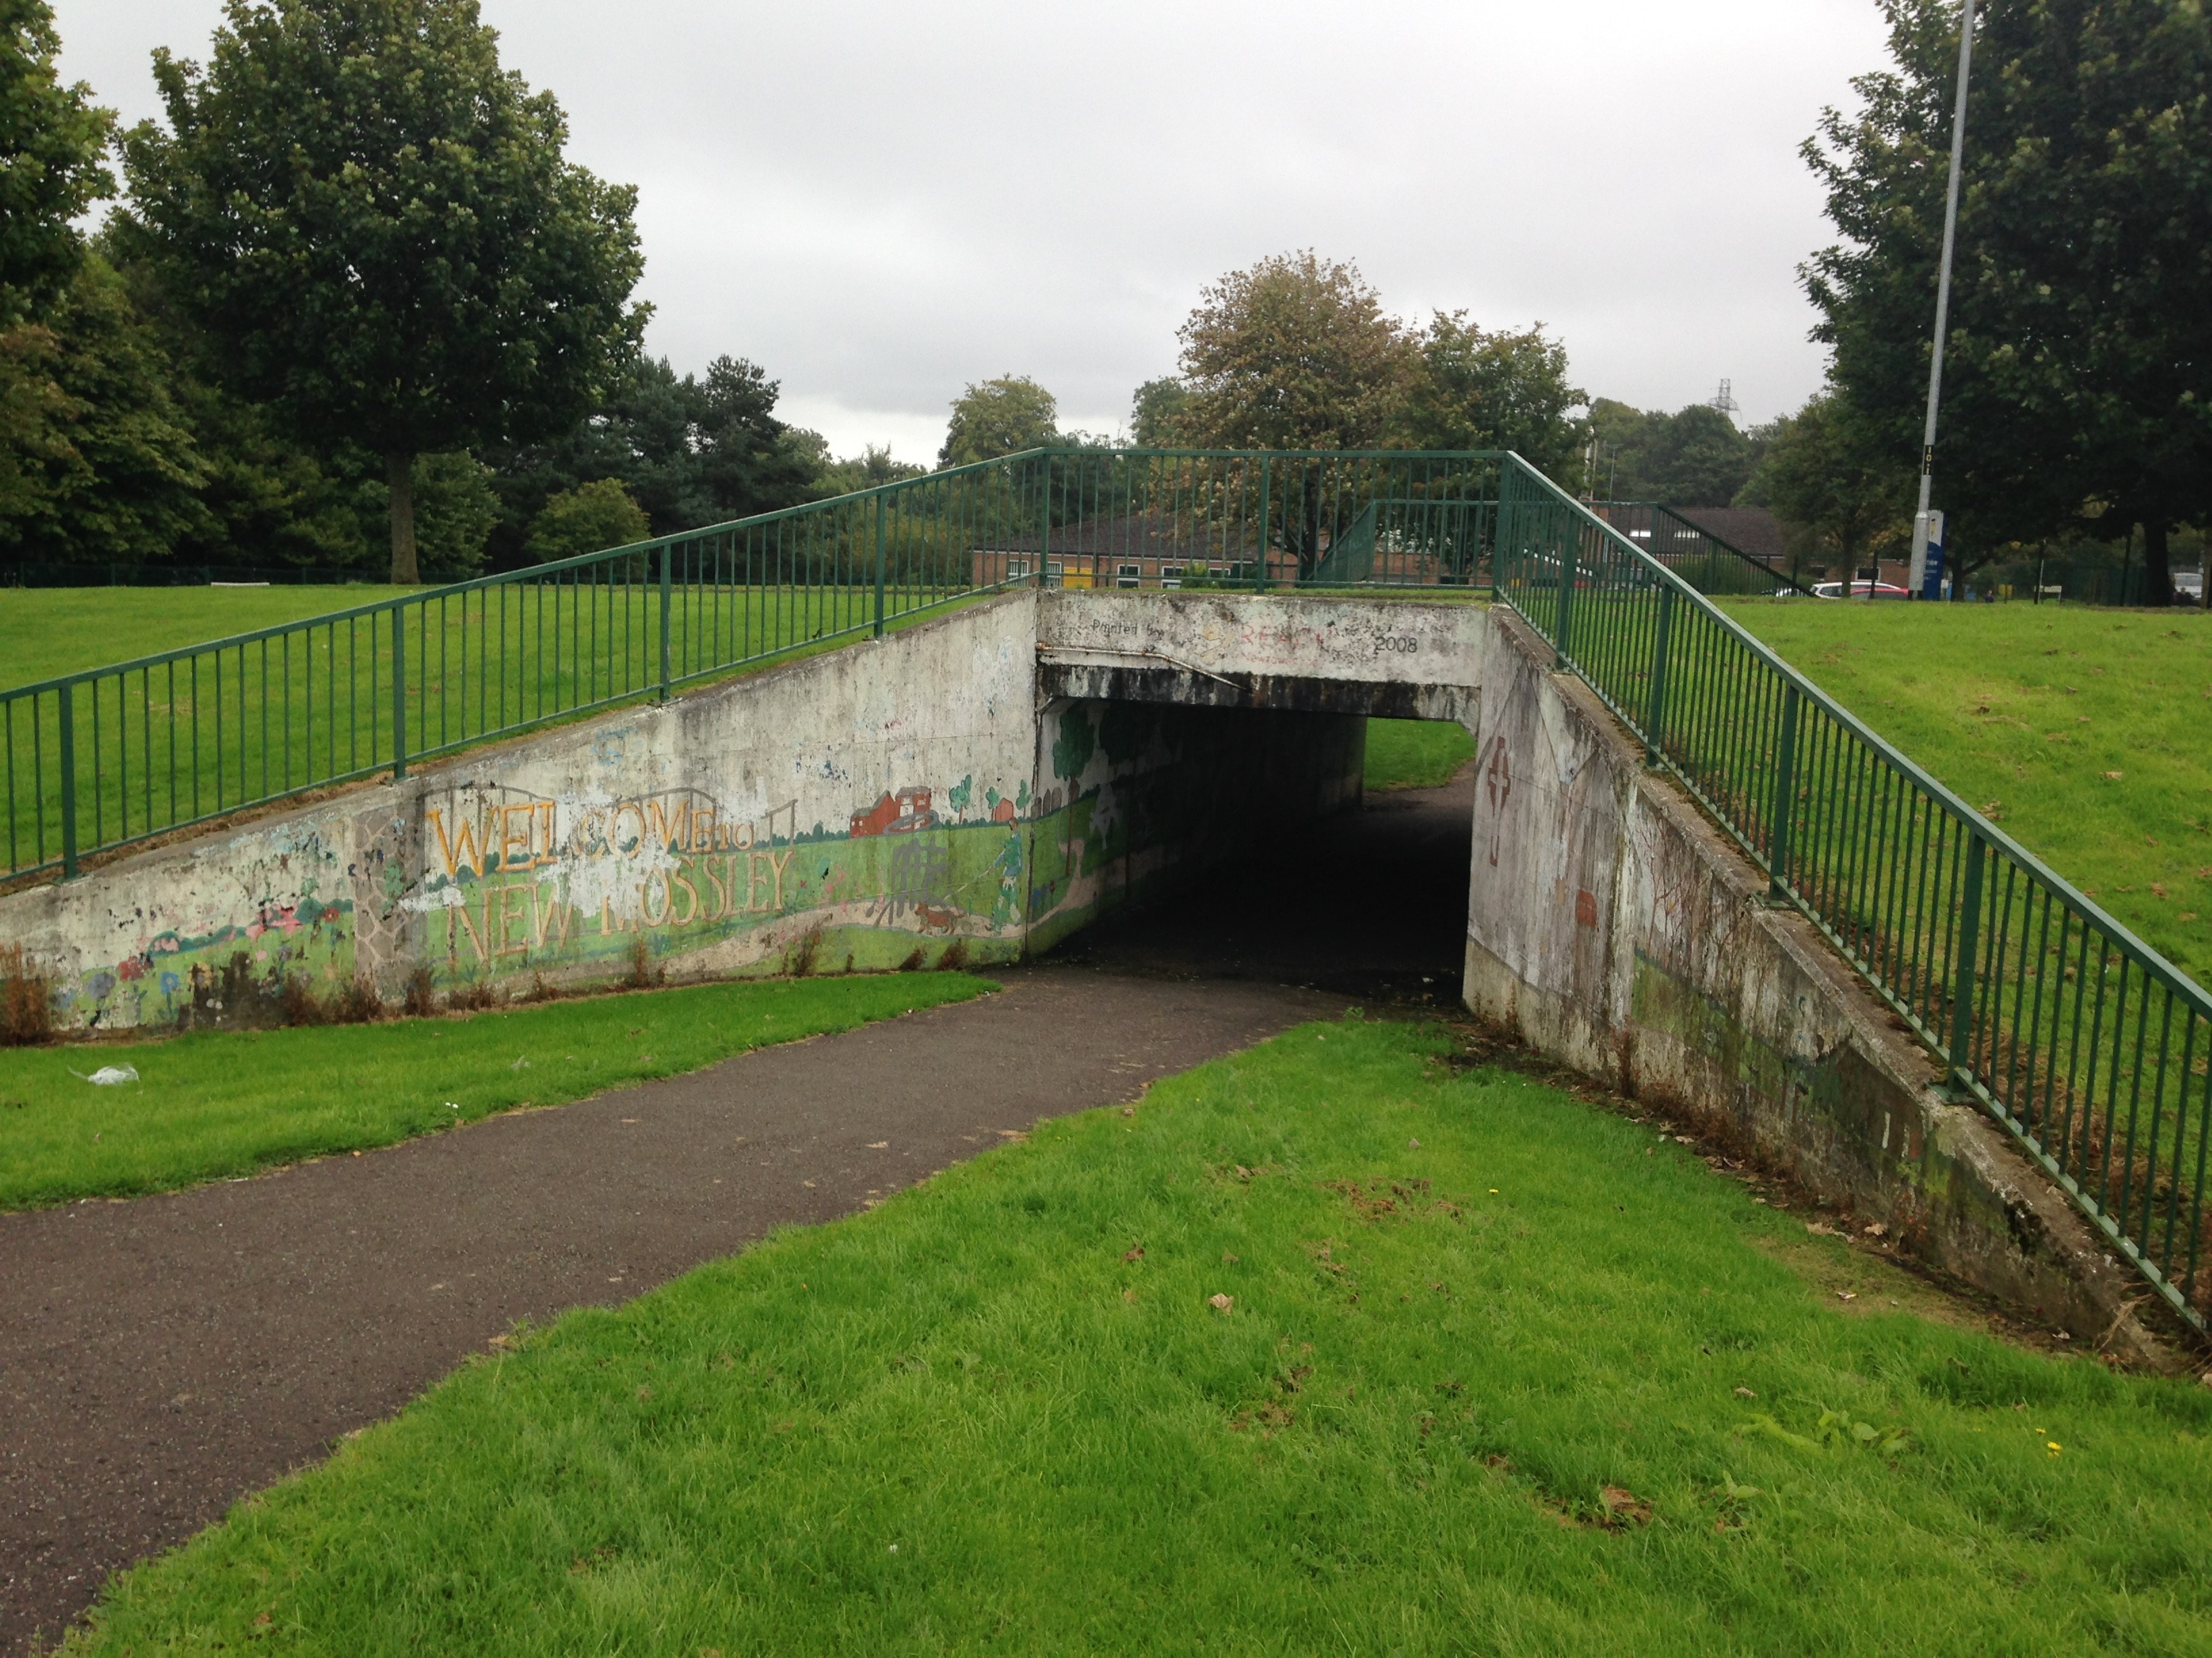
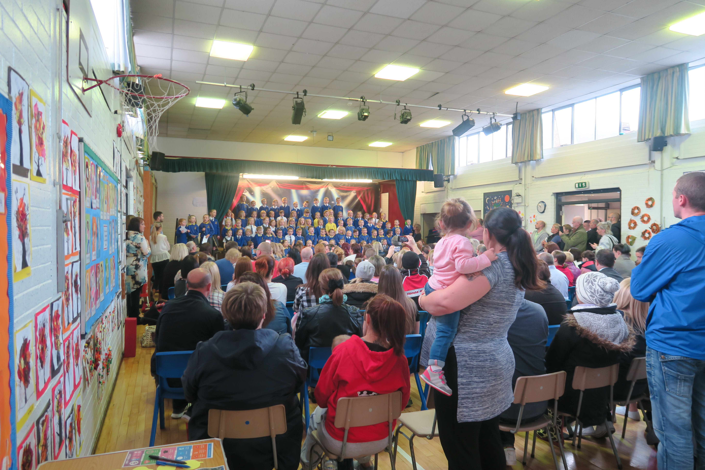
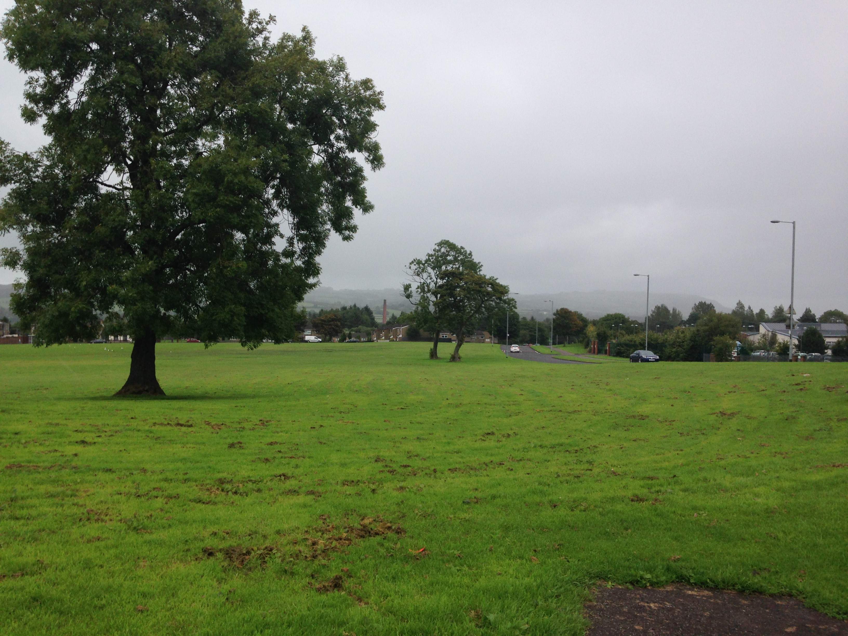
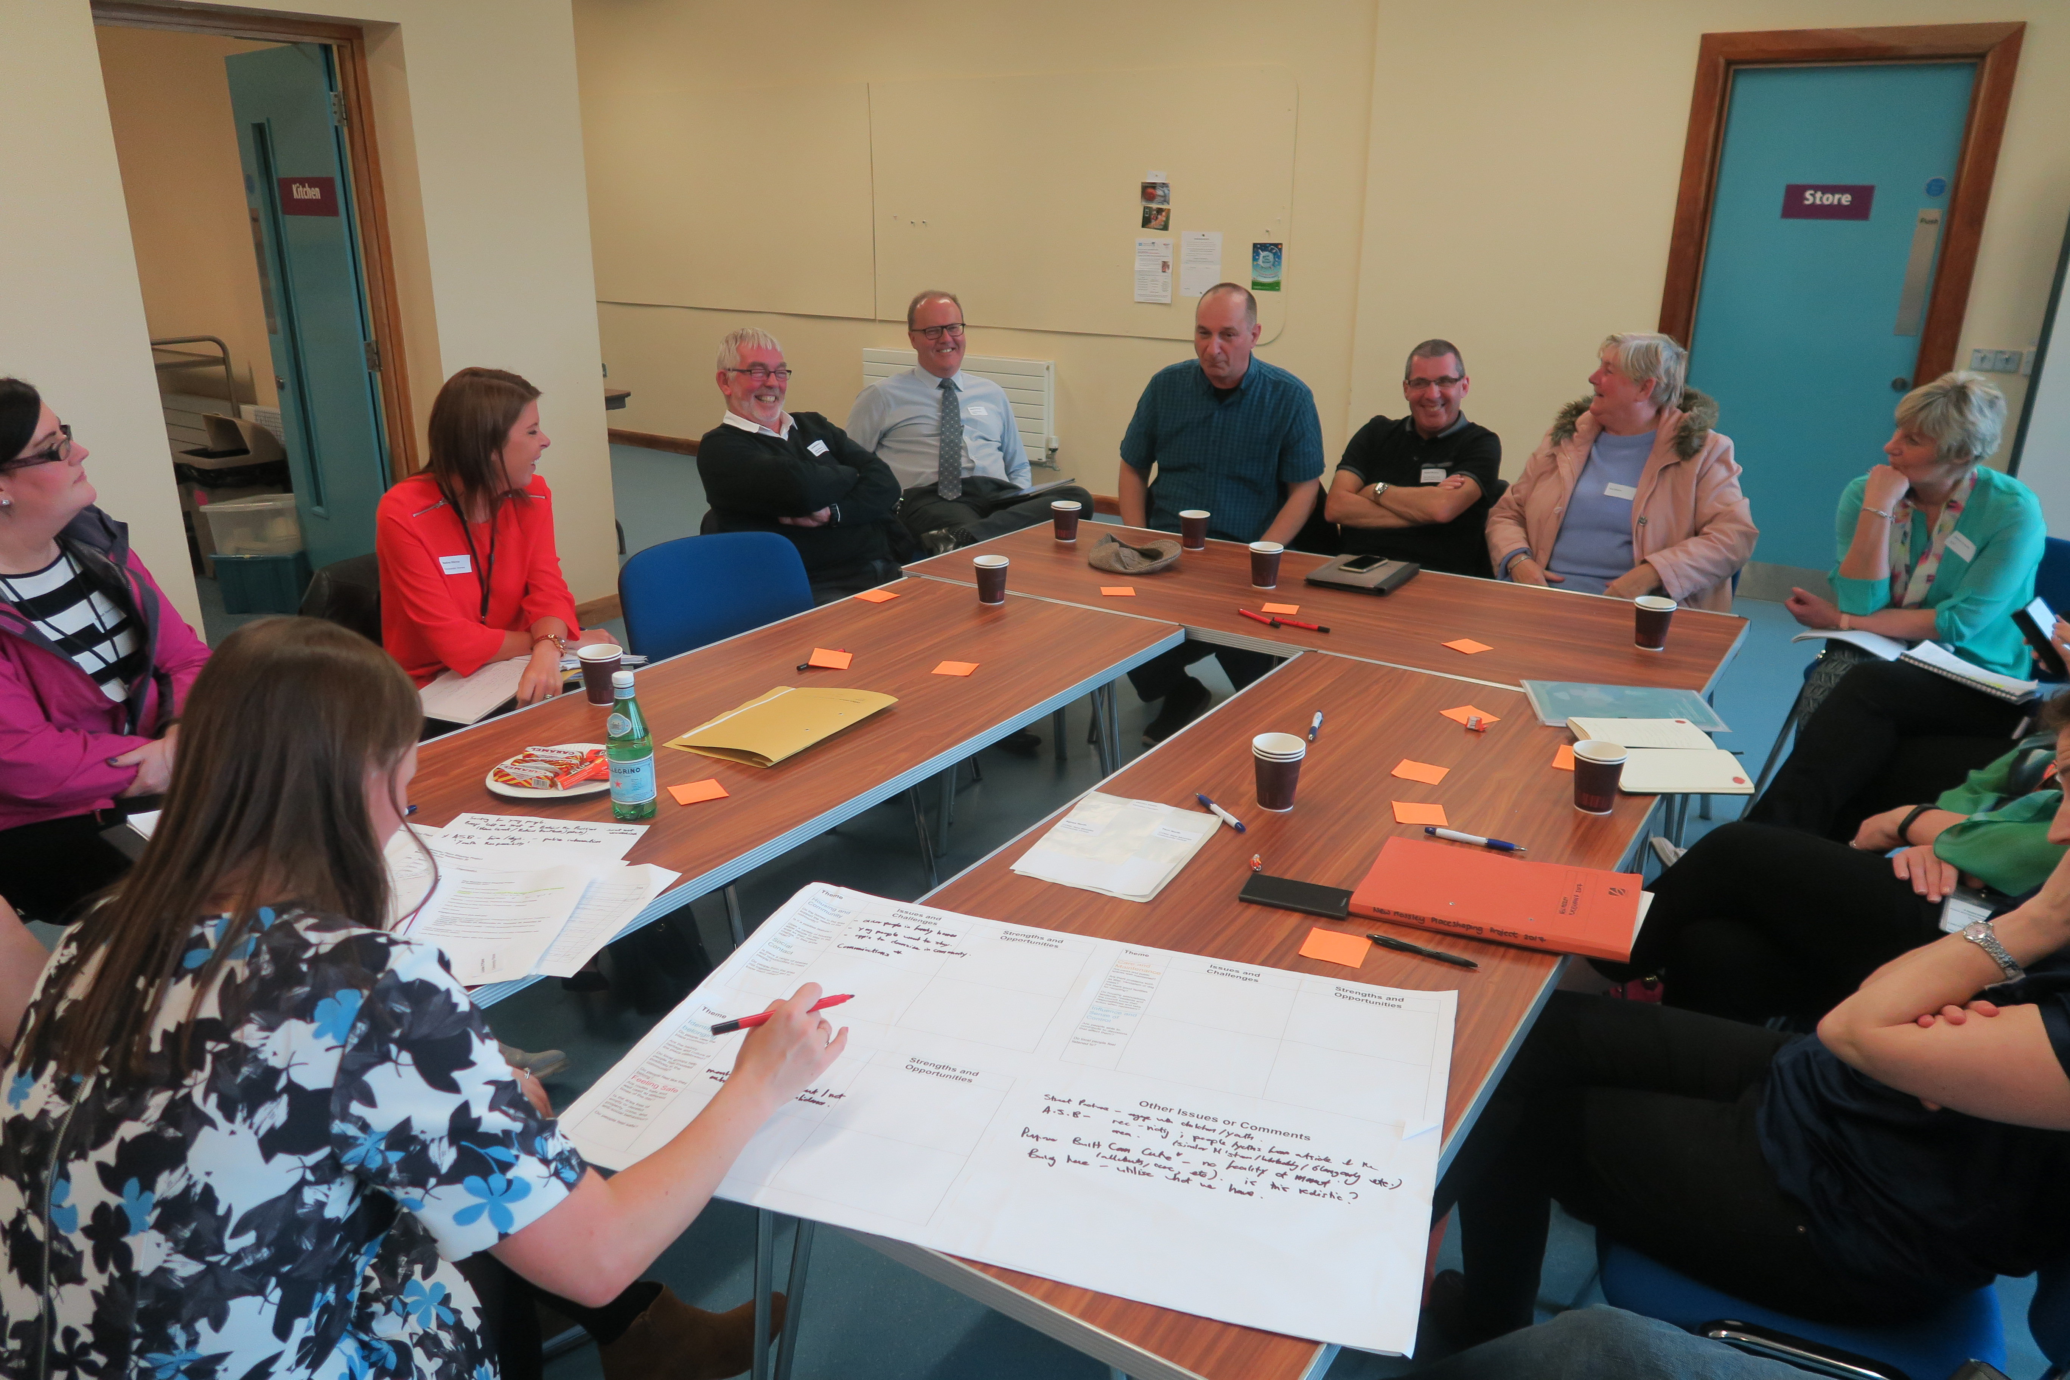
NEW MOSSLEY PLACE SHAPING PROJECT: Community Places, Dr Louise O’Kane

Slide 2
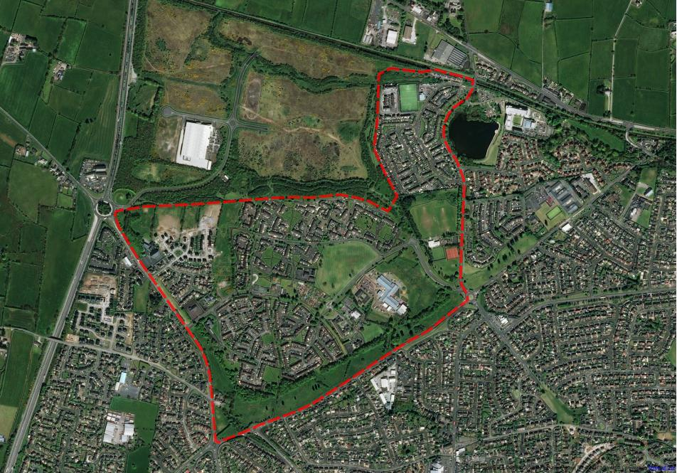
New Mossley place shaping Process
Stakeholder Engagement
Spatial Audit Mapping Social and Physical Infrastructure and Assets
Area Profile
Community Engagement
Place Standard
Engagement Findings and Emerging Priorities
Final Regeneration Strategy and Implementation Plan
Notes:
Community Planning approach
Socio-economic profile of the Area
Land Ownership
Physical and Service Infrastructure
Asset base
Community Engagement
* probably don’t need this page for my info***

Slide 3
Project area

Slide 4
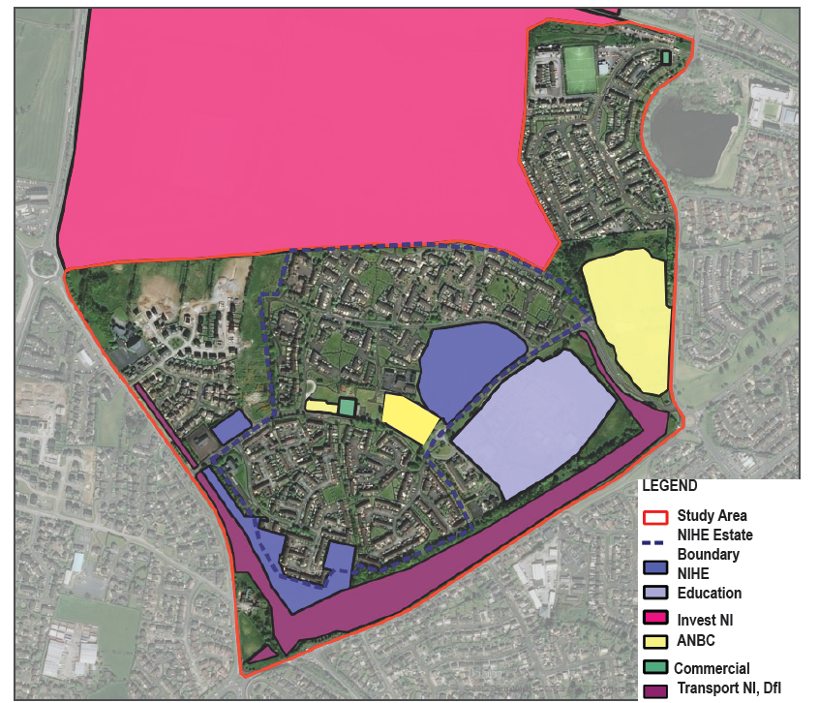
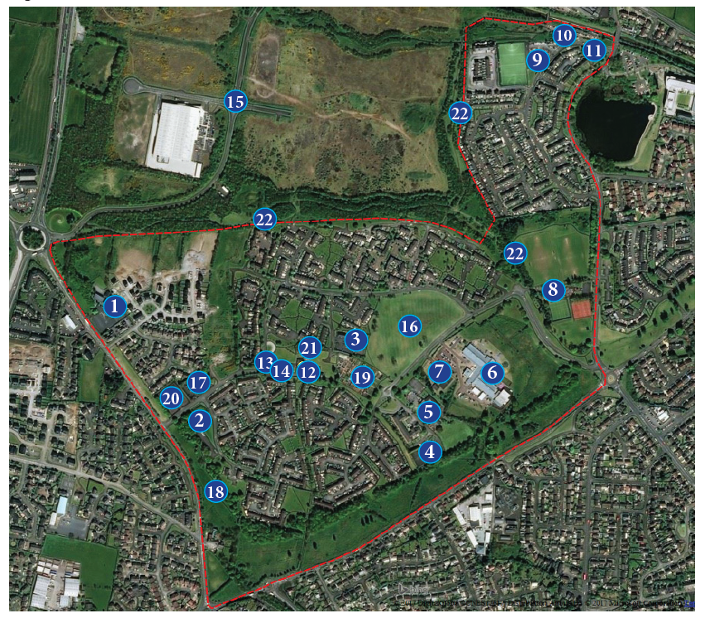
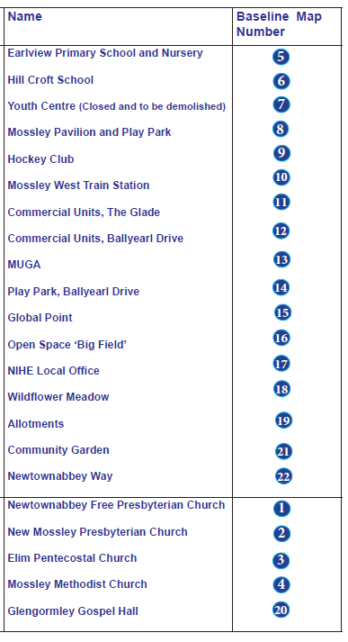
LAND OWNERSHIP
SOCIAL AND PHYSICAL ASSETS

Slide 5
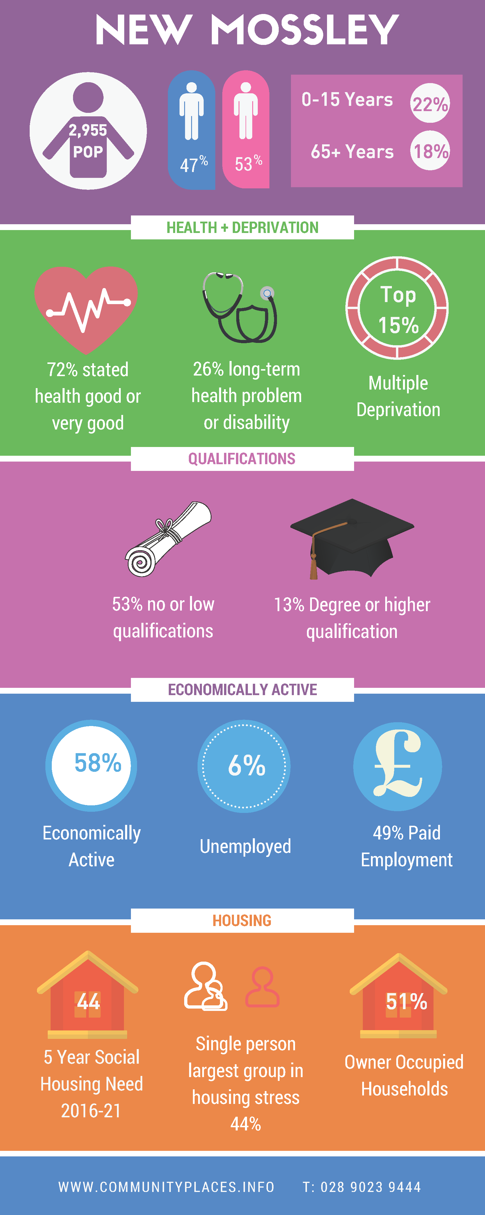
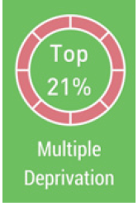
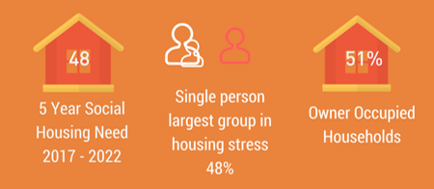
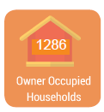
KEY STATISTICS

Slide 6
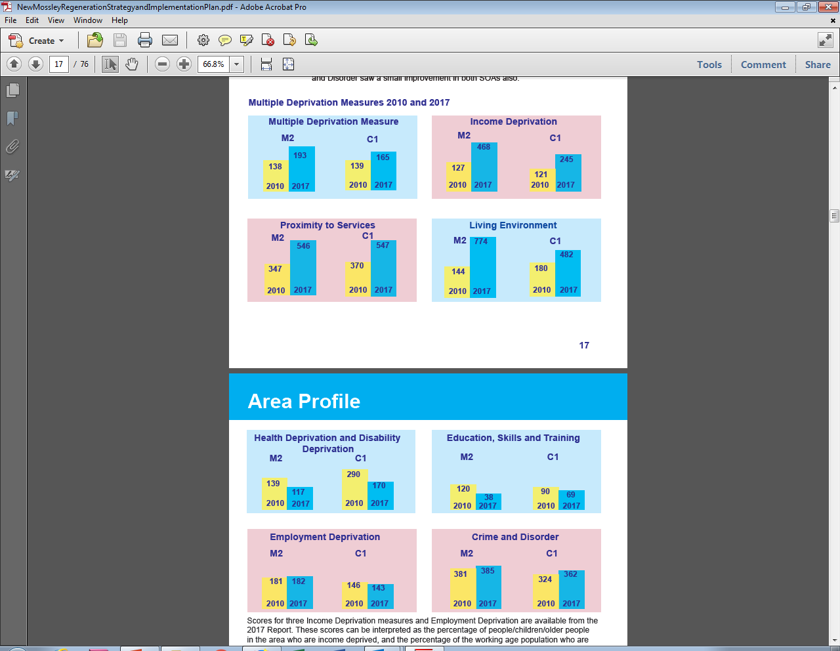

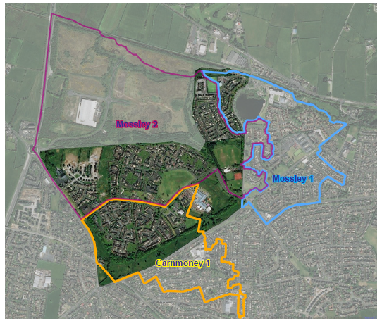

Mdm 2010 and 2017

Slide 7
ENGAGEMENT ACTIVITES
Local Steering Group and Statutory Service Providers
Posters, leaflets, social media, word of mouth
Art and Poetry Competition – leaflets home with each child
2 Engagement Open Days - 4 sessions: Earlview PS Harvest Festival; Church
Café and Mossley Pavilion
Youth Engagement Focus Groups – NME Youth and NMPC Youth Clubs
Women’s Group Focus Group

Slide 8
Key engagement findings
Visual appearance and image of the area: paths and trails; underpass at Manse Way, shops and bus stops; mural and kerb painting
Road safety, Parking and Public Transport: safe crossing point at Manse Road; parking congestion at Earlview Primary School; turning circle; active travel; traffic calming; experience of public transport; unmet travel needs
Housing need: awareness and support for housing; ‘Big Field’ site identified; opportunity to enhance open space; good communication between community, NIHE and Connswater Homes
Enhanced open space and greater connectivity: link to Newtownabbey way, Woodland and Wildflower way and open up area; asset of green ribbon

Slide 9
KEY engagement findings
Facilities and services: closure of Youth Centre; lack of activities for young, children with disabilities; older people; over 35s. Services: advice; library; internet access; health and well-being; toilet facility at Allotments; size and weight of bins; food waste bags.
Absence of Community Space, opportunities to better use existing facilities and buildings: parks well used; Church based Youth Clubs; Allotments; Church Café; Elim Hall; Mossley Pavilion.
Positive change: willingness to work together with a range of partners for benefit of the whole area; capacity building and support.
Youth Engagement: litter and dog fouling, bins, underpass – more colourful; youth centre; activities and clubs; CCTV to feel safe; like schools, youth clubs, friends, forest walk, creative ideas – tiger and a helicopter pad.

Slide 10
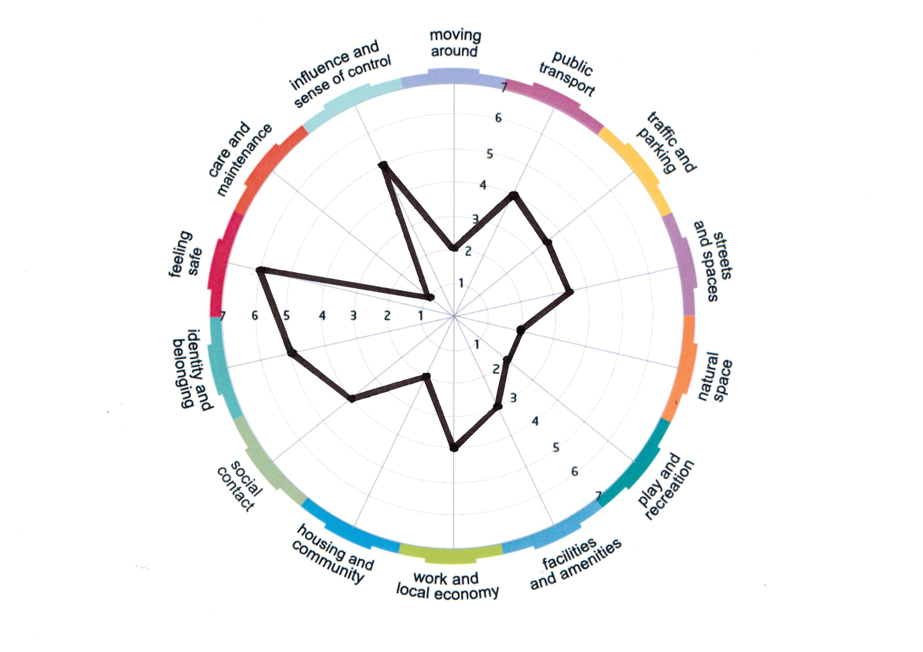
PLACE STANDARD
Care and Maintenance 1
Moving Around 2
Housing and Community 2
Natural Space 2
Play and Recreation 2
Facilities and Amenities 3
Traffic and Parking 3.5
Streets and Spaces 3.5
Public Transport 4
Social Contact 4
Work and Local Economy 4
Identity and Belonging 5
Influence and Sense of Control 5
Feeling Safe 6
Notes:
Clear recognition that there is a positive feeling within the area – moving forward, eagerness to work with other organisations and groups for benefit of entire area
People generally enjoy living in the area; feel safe, recognised difficulties in the past but positive change happening.

Slide 11
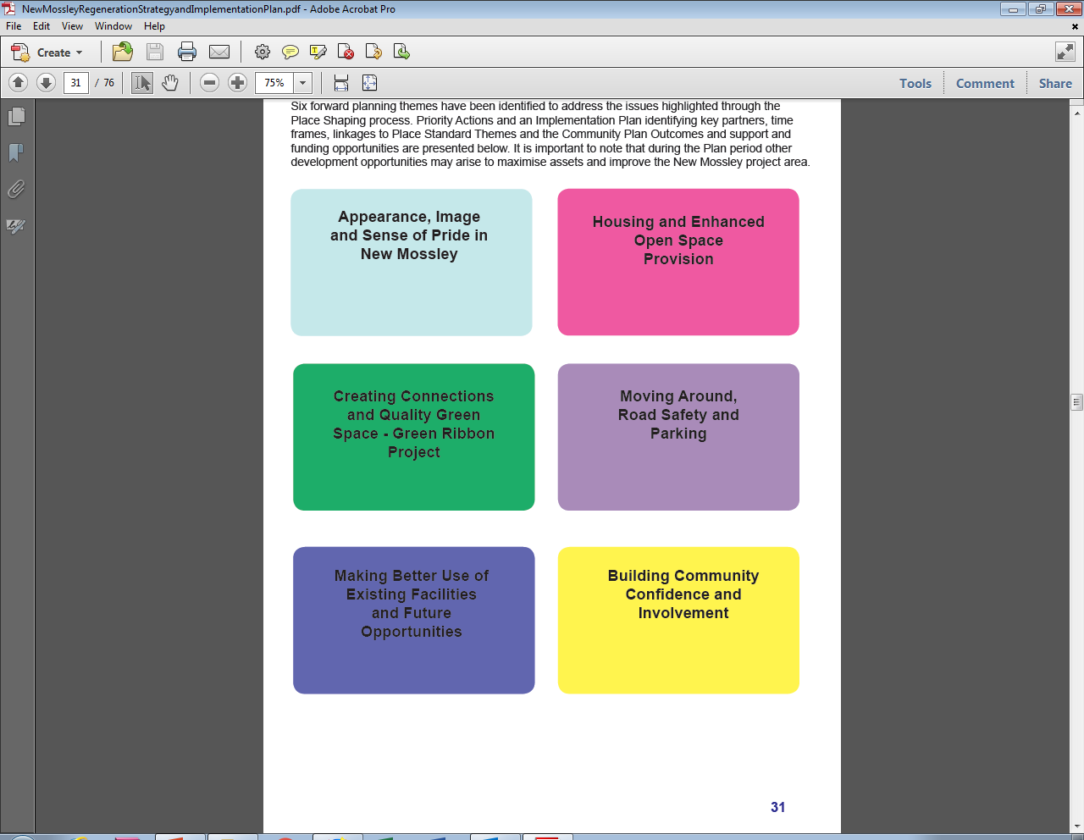
Priority actions and implementation

Slide 12
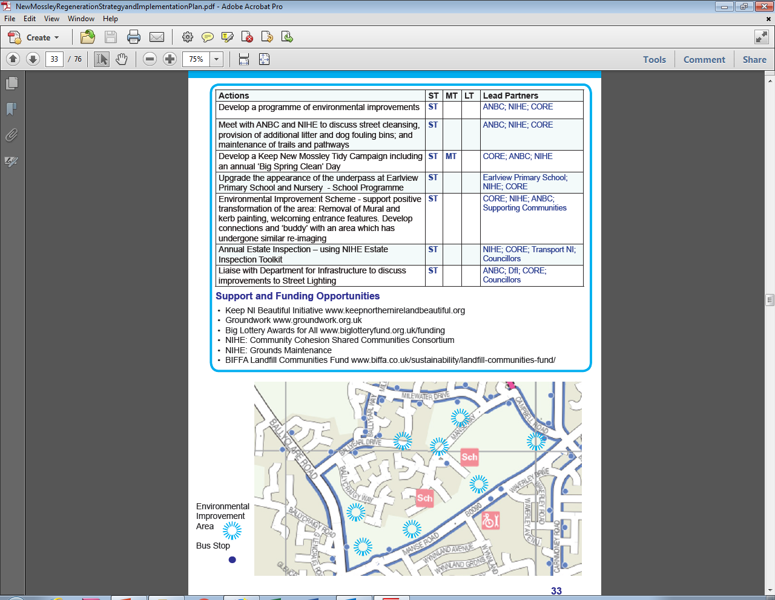

Slide 13
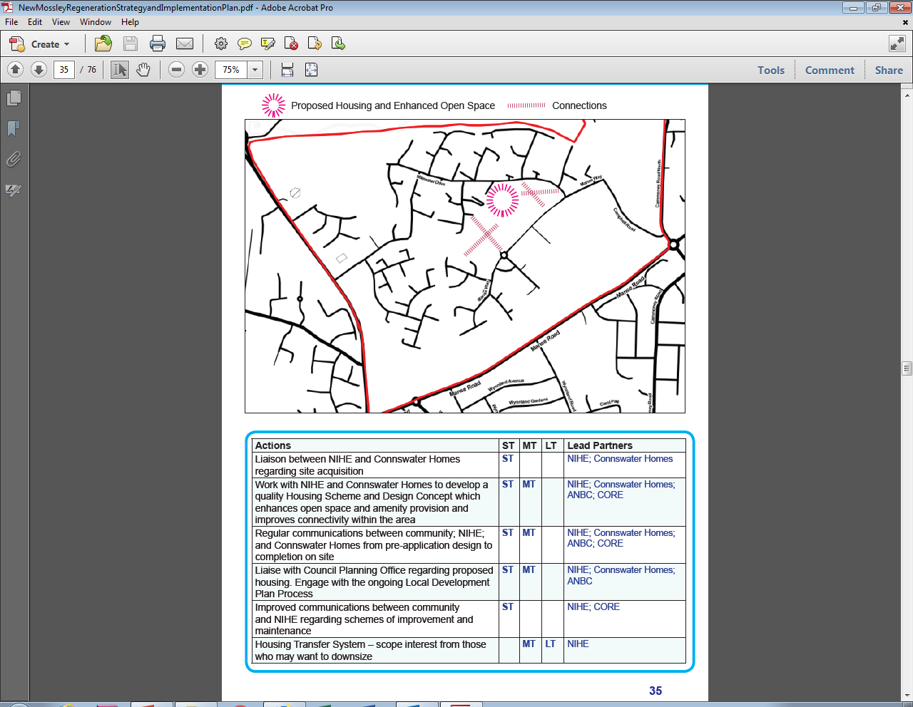

Slide 14
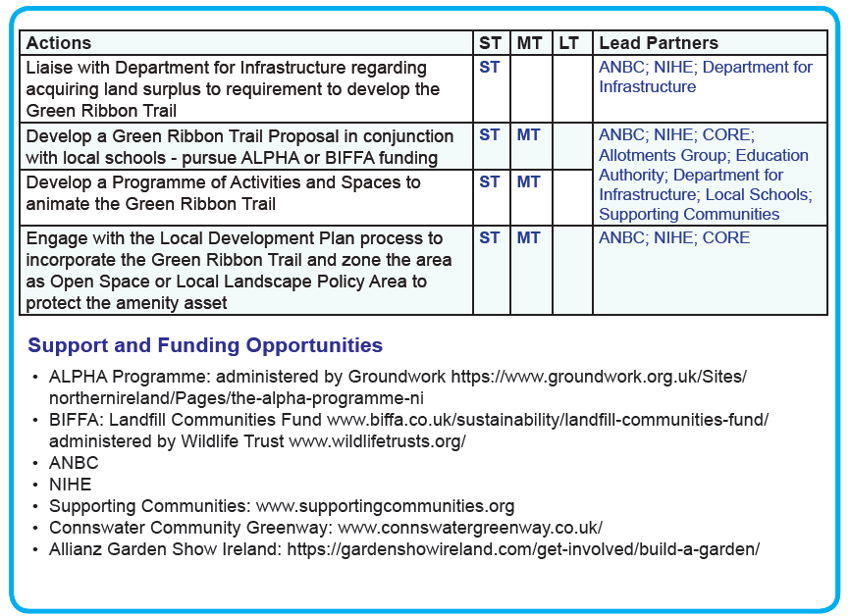
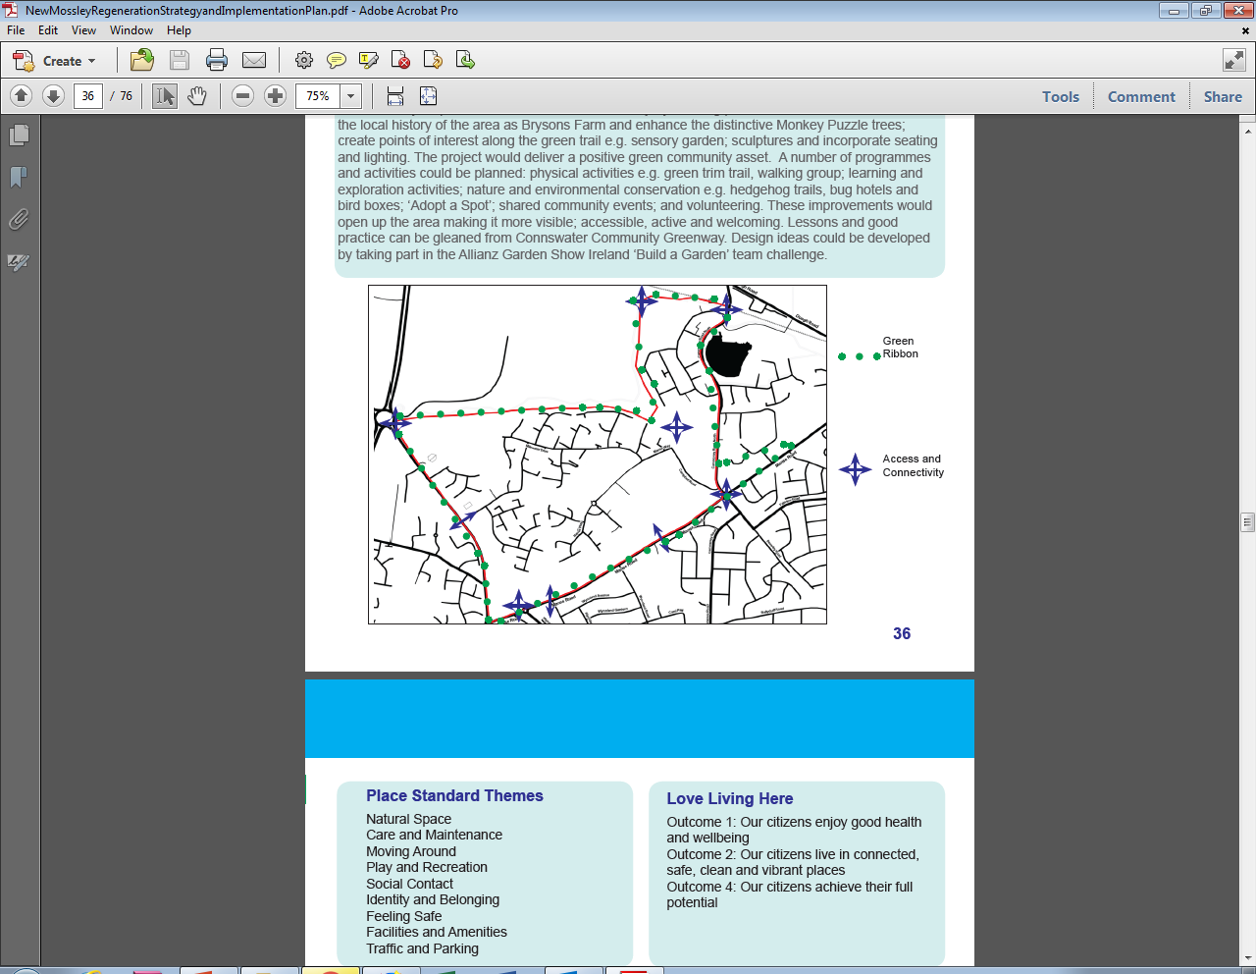

Slide 15
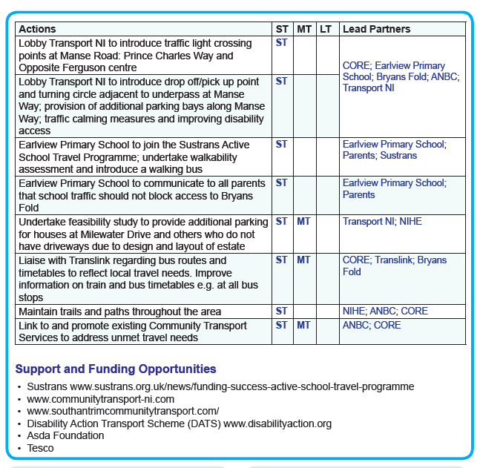
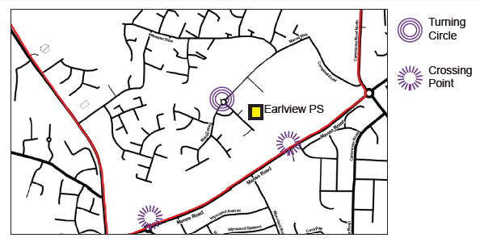

Slide 16
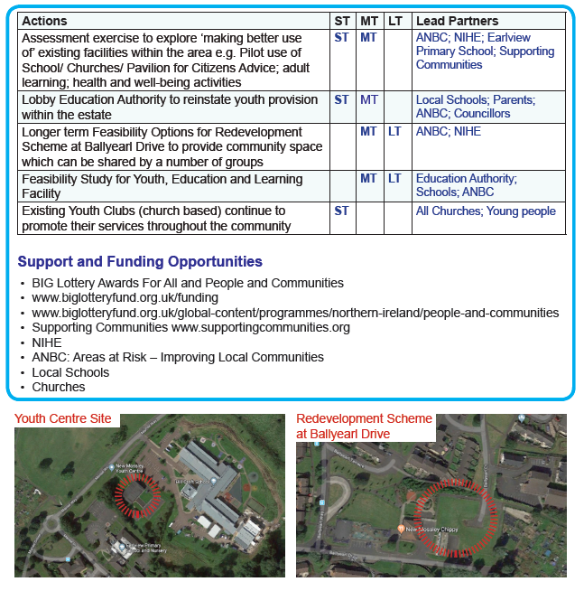
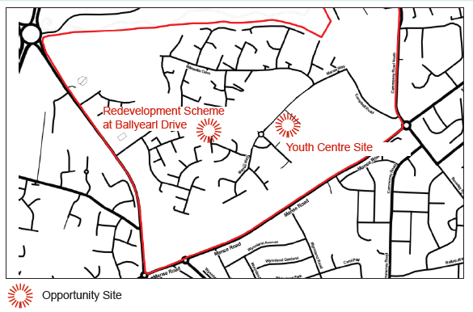

Slide 17
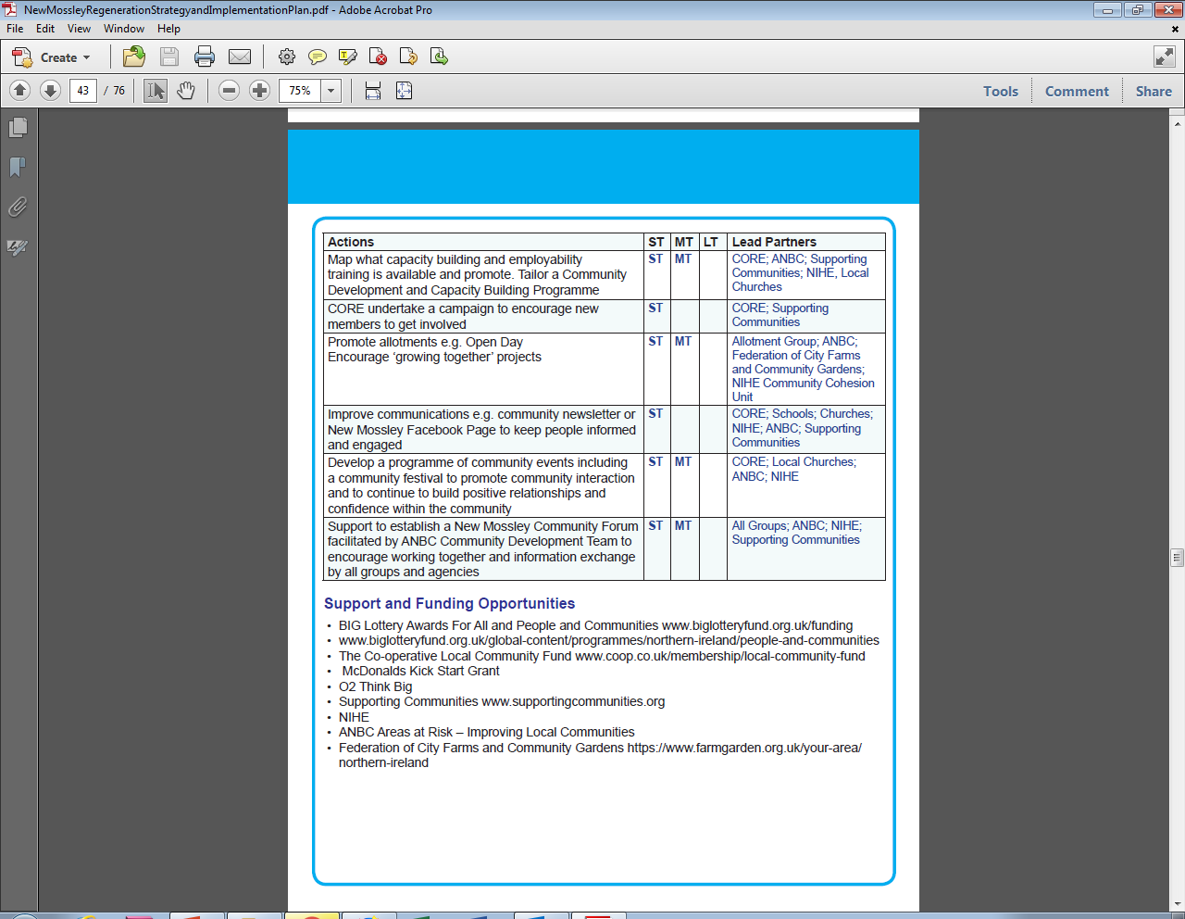


Slide 18
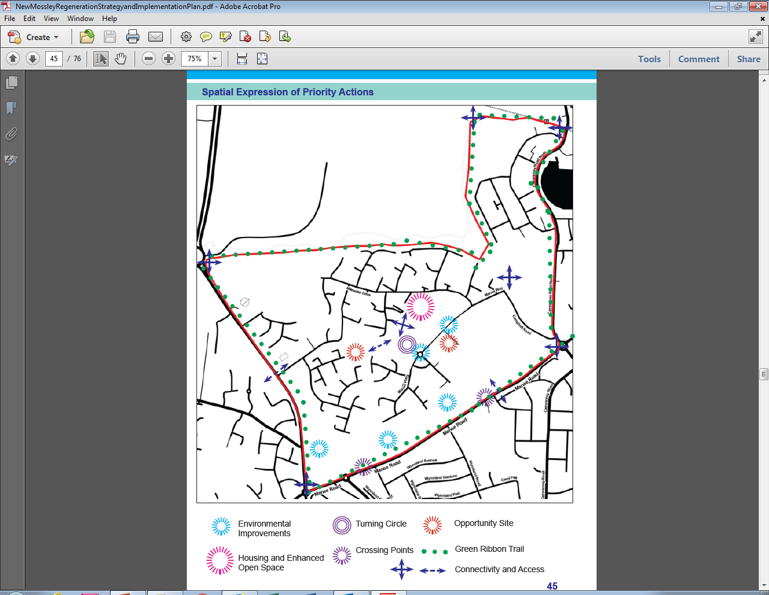

Slide 19
Thank you
Louise@communityplaces.info
028 9023 9444

